Slide 1
By: Jen Bond, Darrell Wallace, Tim Van Beek
Welcome!!!
Grants 201 Training
February 18, 2025
Notes:
Jen

Slide 2
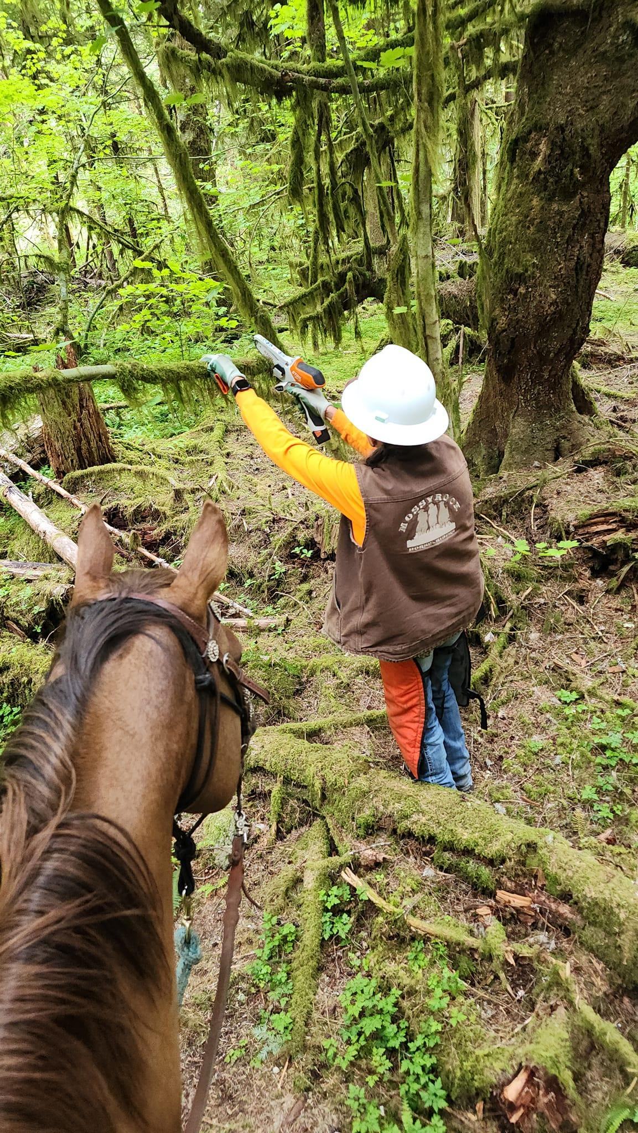
Agenda – Grants 201 Training
BCHW Grants Team – Grant Committee & contractor help
Volunteers & Grants– Liaison duties & responsibilities
Grant Reimbursements – How to use grants to pay for project expenses:
What grants can pay for and what they cannot pay for…
Supporting documentation like receipts & invoices
W-9 requirements for reimbursing volunteers
Field sheets
BCHW credit cards
What is match and how to document it
Grant progress reporting
Notes:
Jen

Slide 3
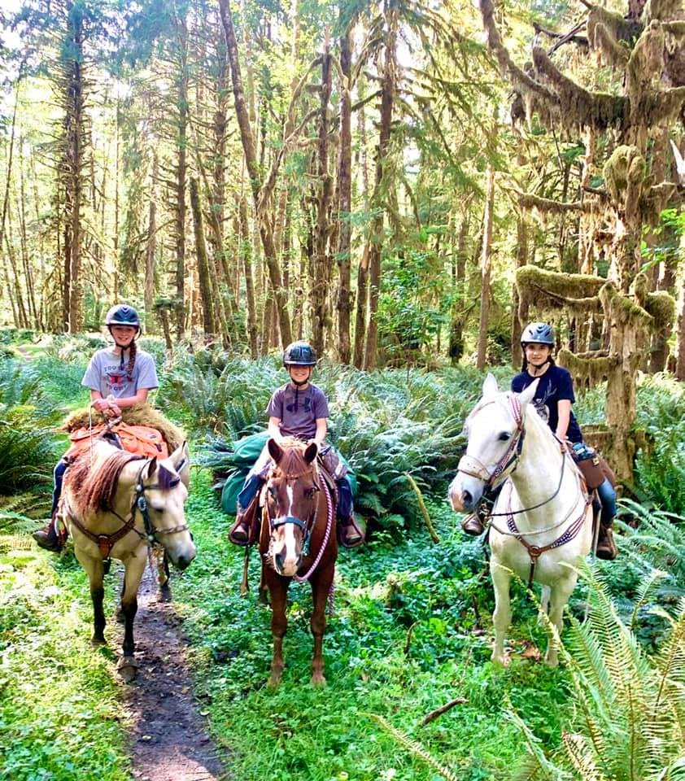
BCHW Grants Team
BCHW Grant Committee:
Darrell Wallace – Chair
Deb Wesselius – Member
Barb Talbot – Member
Mark Vorce – Member
Rob DeBoer - Member
BCHW Grant Contractors
Jen Bond – Grant administration
Tim Van Beek – Project manager
Three youth riders out enjoying the Bogachiel River Trail, a current RTP project worksite.
Notes:
Darrell – please acknowledge the Grants Committee and then introduce Tim and Jen and let them speak for a few mins on what their involvement is with grants

Slide 4
Grant Liaisons No Grant Liaisons, No Grants!
Grant liaisons – Volunteers that are coordinating grant administration for their chapter.
Grant liaison responsibilities:
Make sure your chapter is following RTP grant contract including keeping track of the budget (Grant Administrator can help with this)
Collect all documentation for billing including:
Receipts, Invoices, etc.
Field Sheets
Expense Reimbursements
Complete reimbursement requests
Complete quarterly progress reports
Report match
Three youth riders out enjoying the Bogachiel River Trail, a current RTP project worksite.
Notes:
Jen

Slide 5
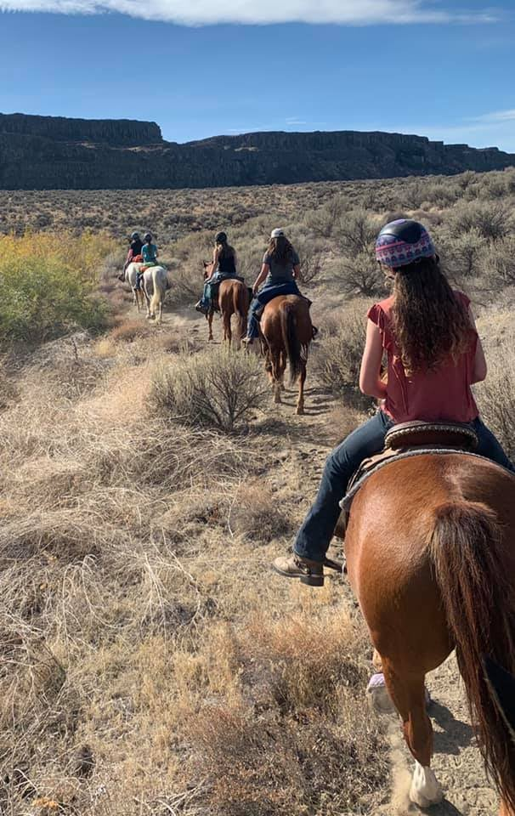
Brief Overview of Grant Reimbursements
Collect all documentation including receipts, invoices, and field sheets.
Fill in the Excel 2025 Expense Reimbursement Form
Attach all supporting documentation like receipts (with signatures), invoices, Field Sheets (completed and signed).
Email EXCEL 2025 Expense Reimbursement Form, with documentation, to BCHW Grant Administrator.
BCHW Grant Administrator reviews reimbursement request, approves request, and submits it to BCHW Treasurer for payment.
BCHW Treasurer sends reimbursement check to volunteer, chapter, or vendor listed on the reimbursement form.
Notes:
Jen

Slide 6
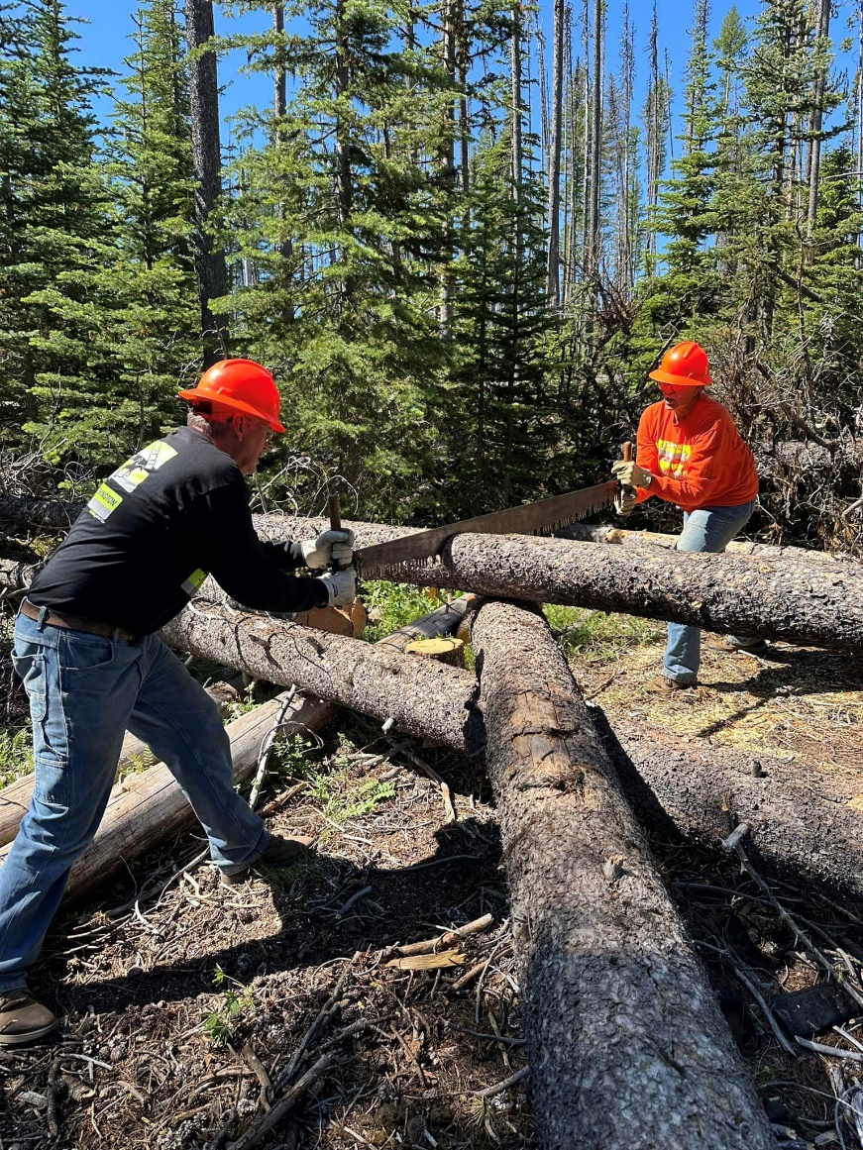
What Grants CAN pay for & what they CANNOT
Grants CAN reimburse expenses such as materials (lumber, hardware, gravel), tools, POV, equipment rental, stock days, per diem (limits).
Grants CANNOT pay for volunteer’s time working on projects (basic or skilled hourly labor rate), any alcoholic beverages, work not on approved project sites, any project expenses not DIRECTLY relevant to implementing the approved grant project.
Not sure if they grant can cover the cost… PLEASE ASK GRANT ADMINISTRATOR FIRST!
Notes:
Jen

Slide 7
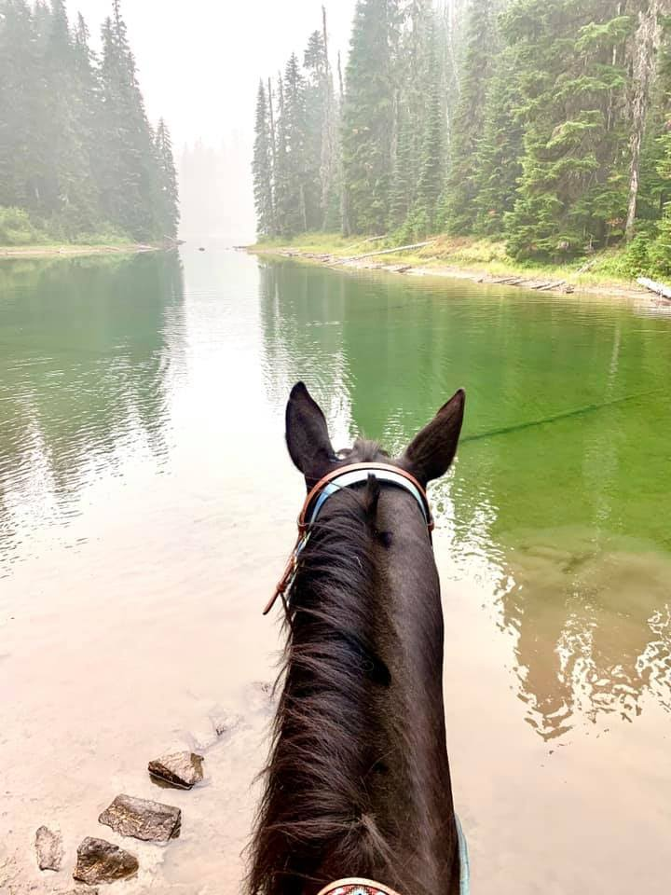
Three Options for Handling Grant Expenses:
Chapter prepares grant reimbursement and documentation and then submits it to BCHW grant administrator for direct reimbursement of volunteers or [direct payment vendors].
Chapter uses BCHW issued credit card to pay for grant expense and turns receipt/invoice into BCHW grant administrator.
Chapter asks BCHW grant administrator to use their BCHW credit card to cover grant expense.
Notes:
Jen

Slide 8
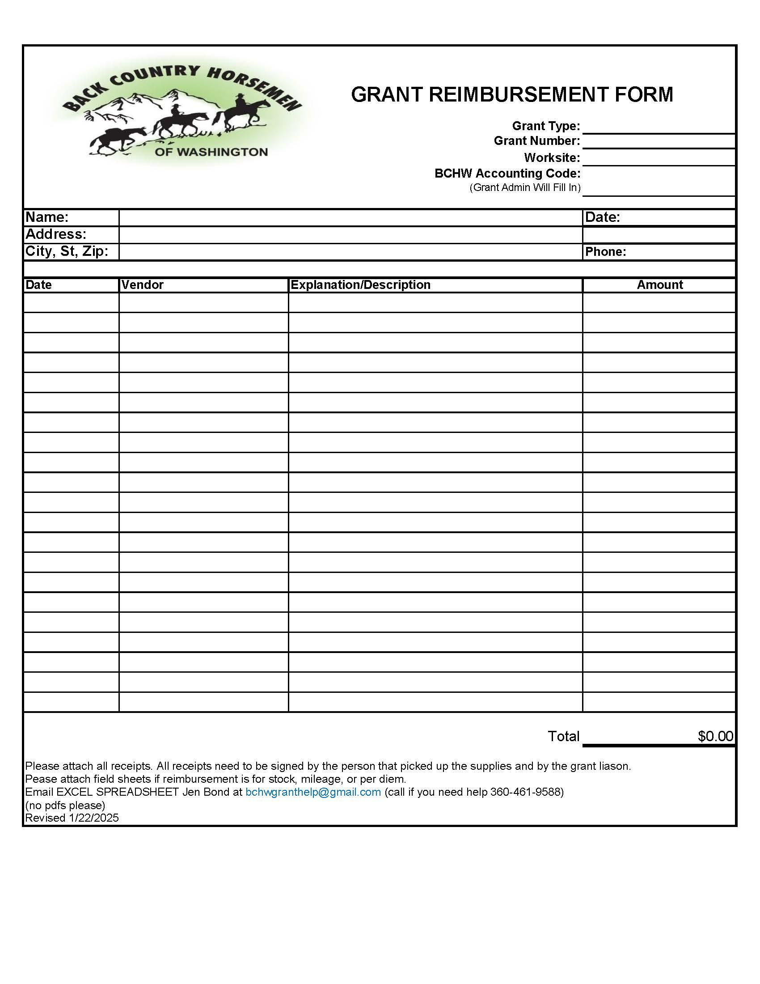
2025 Grant Reimbursement Form
Use this form for all reimbursements EXCEPT for BCHW credit cards.
Ensure you are using the correct 2025 Form (visit BCHW.org/Secure/Grants)
This is an Excel document and should be filled in electronically.
Send Excel spreadsheet to BCHW grant administrator (not a pdf).
Ensure all documentation is attached (Examples - receipts, field sheets, invoices).
Notes:
Jen

Slide 9
Step #1 - FILL IN:
Grant Type (likely RTP),
Grant Number (a 6 digit number like 22-1892)
Worksite – You likely have multiple work sites within your RTP project, you need to submit 1 reimbursement form per worksite (do not combine worksites)
BCHW Accounting Code – Leave blank
Step #2 - FILL IN:
Name, Address, Phone –BCHW will be issue a check to the person/entity that is in this box.
Date – This is the date associated with your reimbursement request, not the date of the work/included expenses.
Step #3 – LIST EXPENSES
Date – The date of the expense (date on a receipt or invoice, date work was performed that is being expensed)
Vendor – Where the item was purchased or who did the work
Amount – Cost from the receipt, invoice, or field sheet.
Total – Sum of all expenses
Notes:
Jen

Slide 10
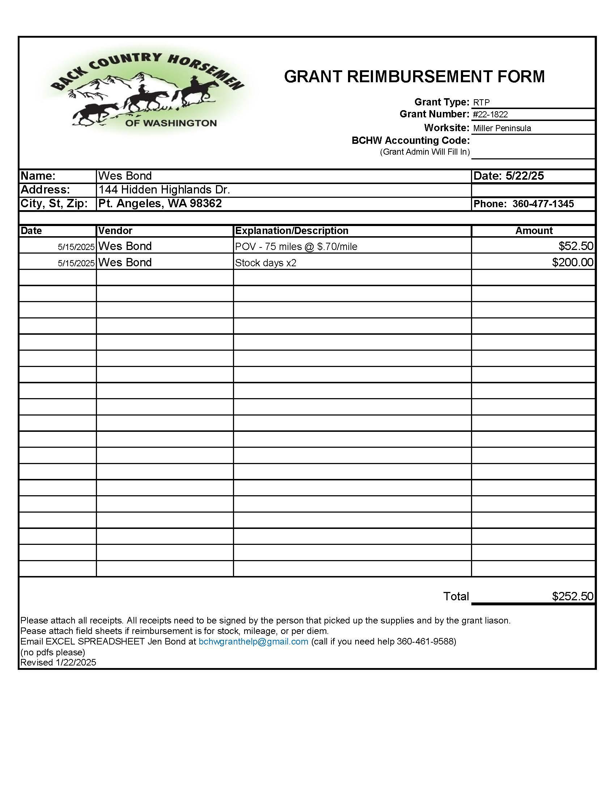
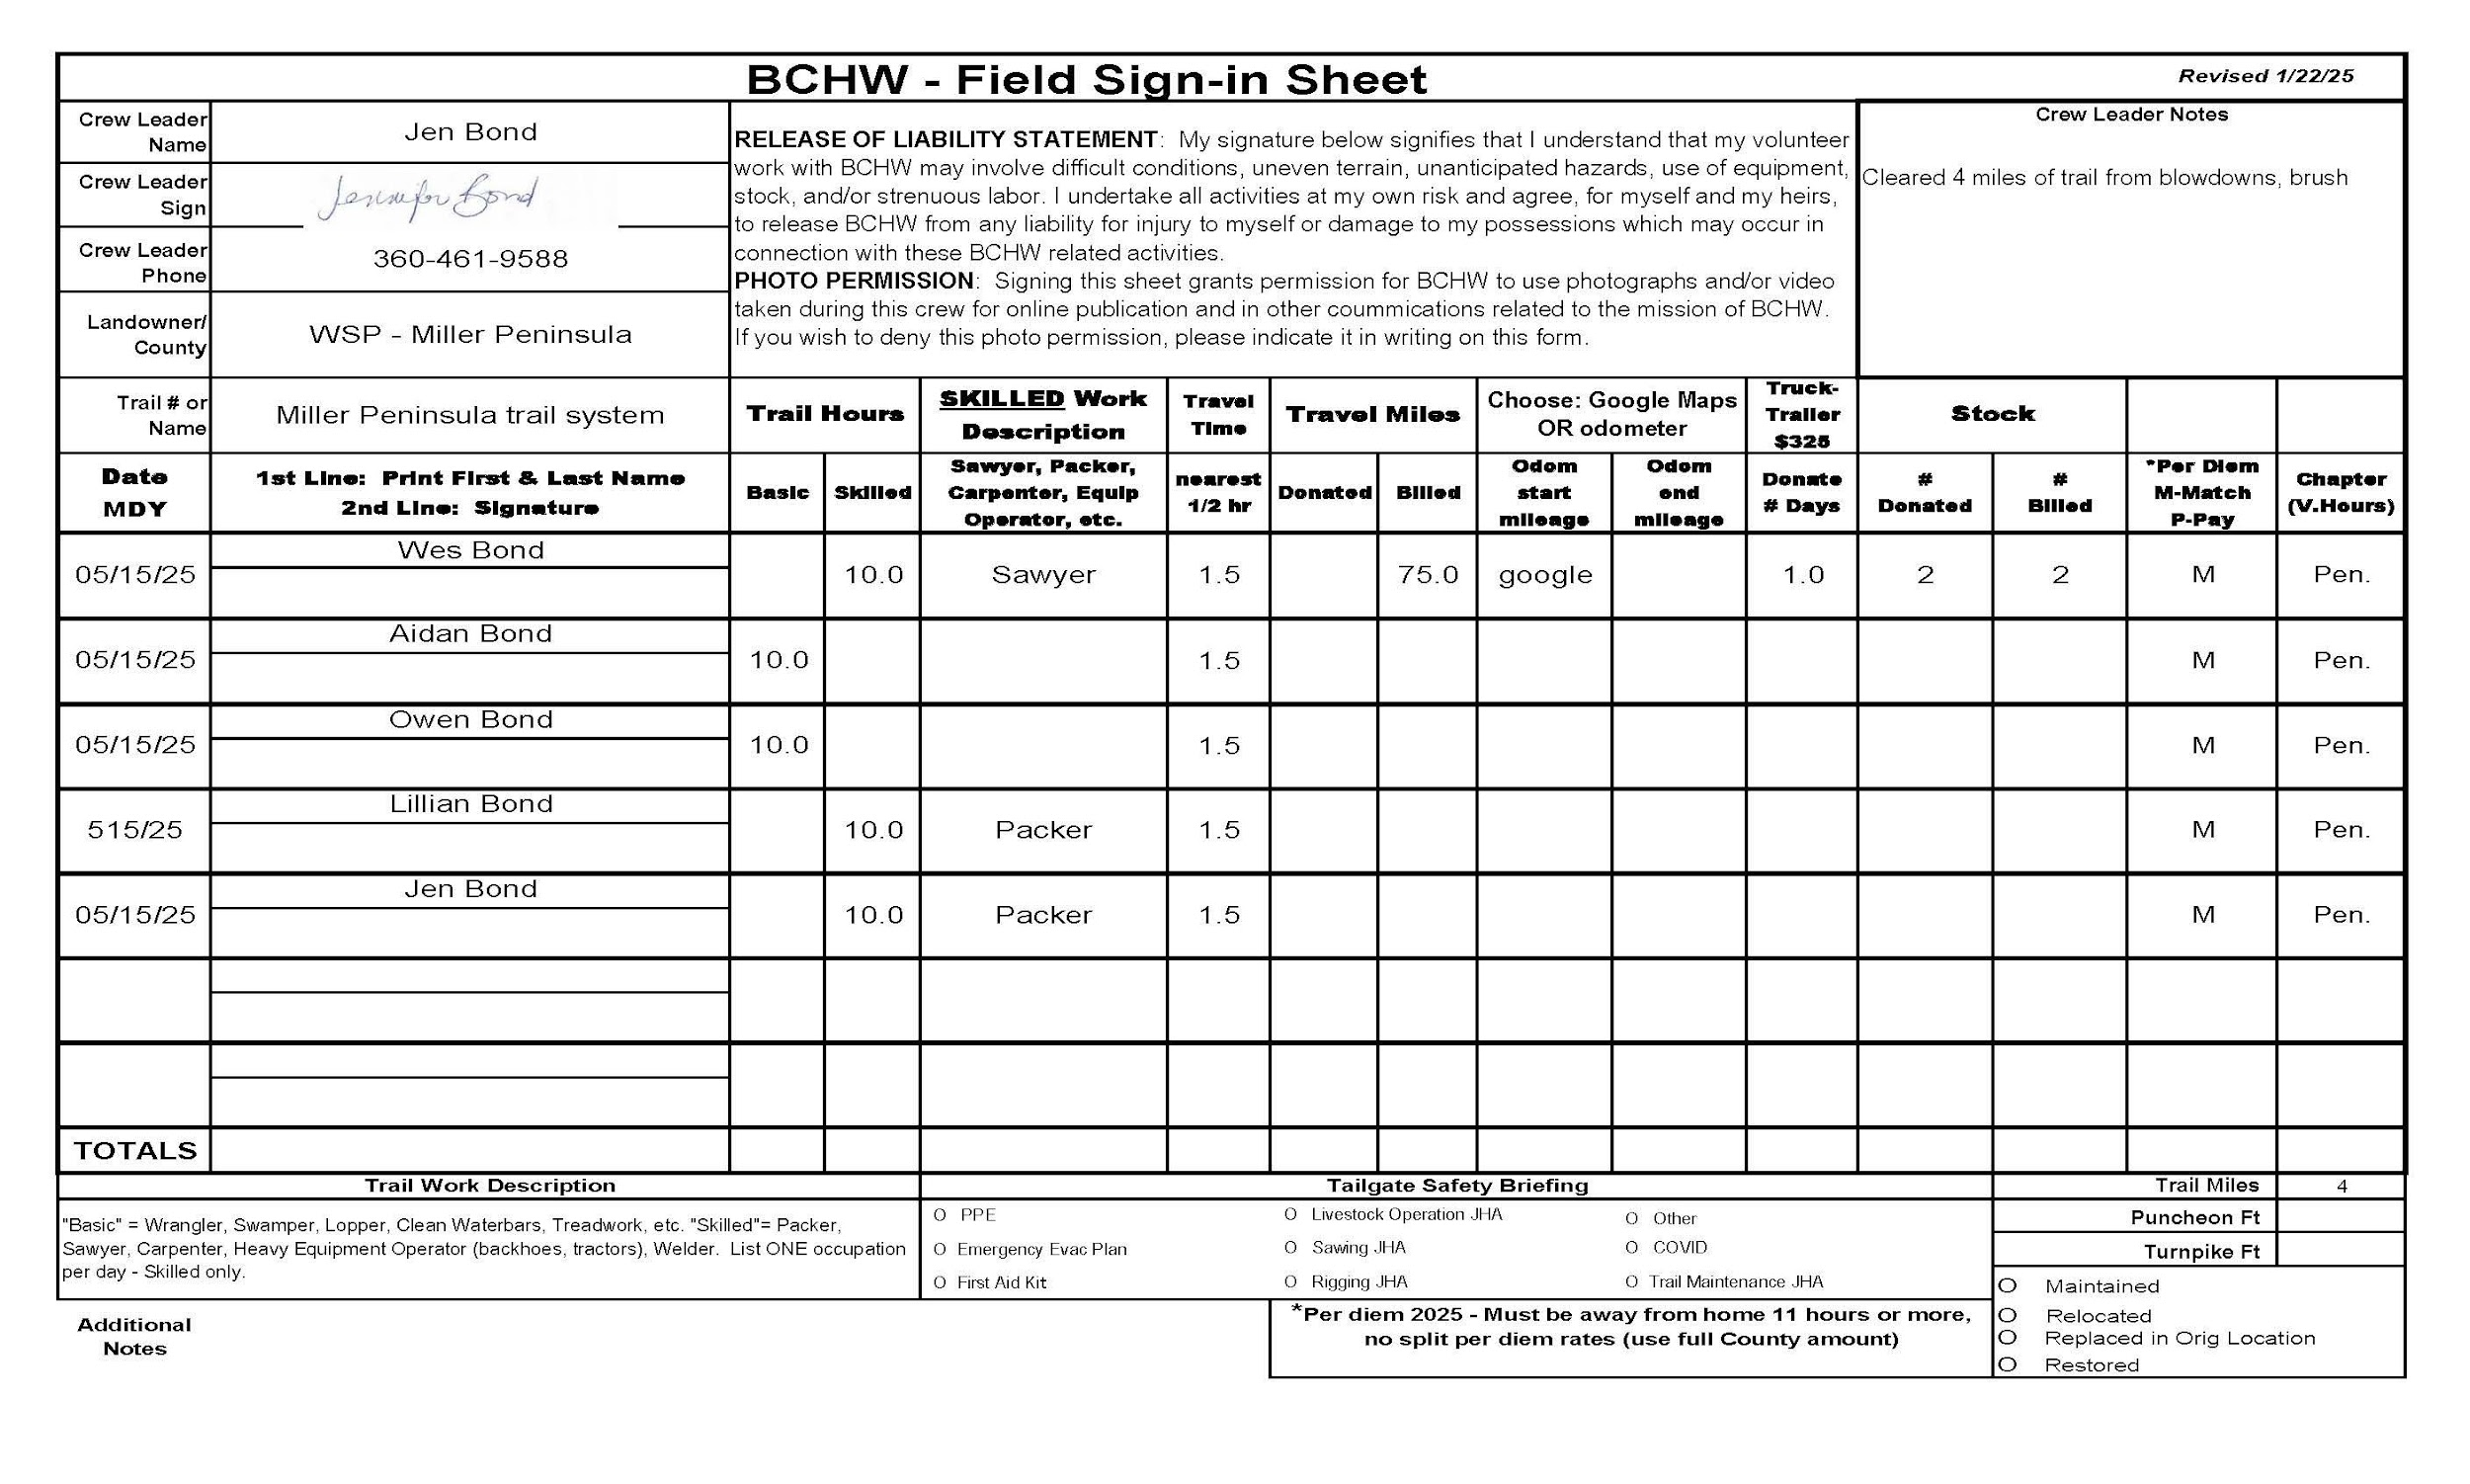
Example of Properly Filled out Reimbursement Form WITH documentation
This field sheet is the required documentation for POV & stock reimbursement. We will also use this to document match…
Notes:
Jen

Slide 11
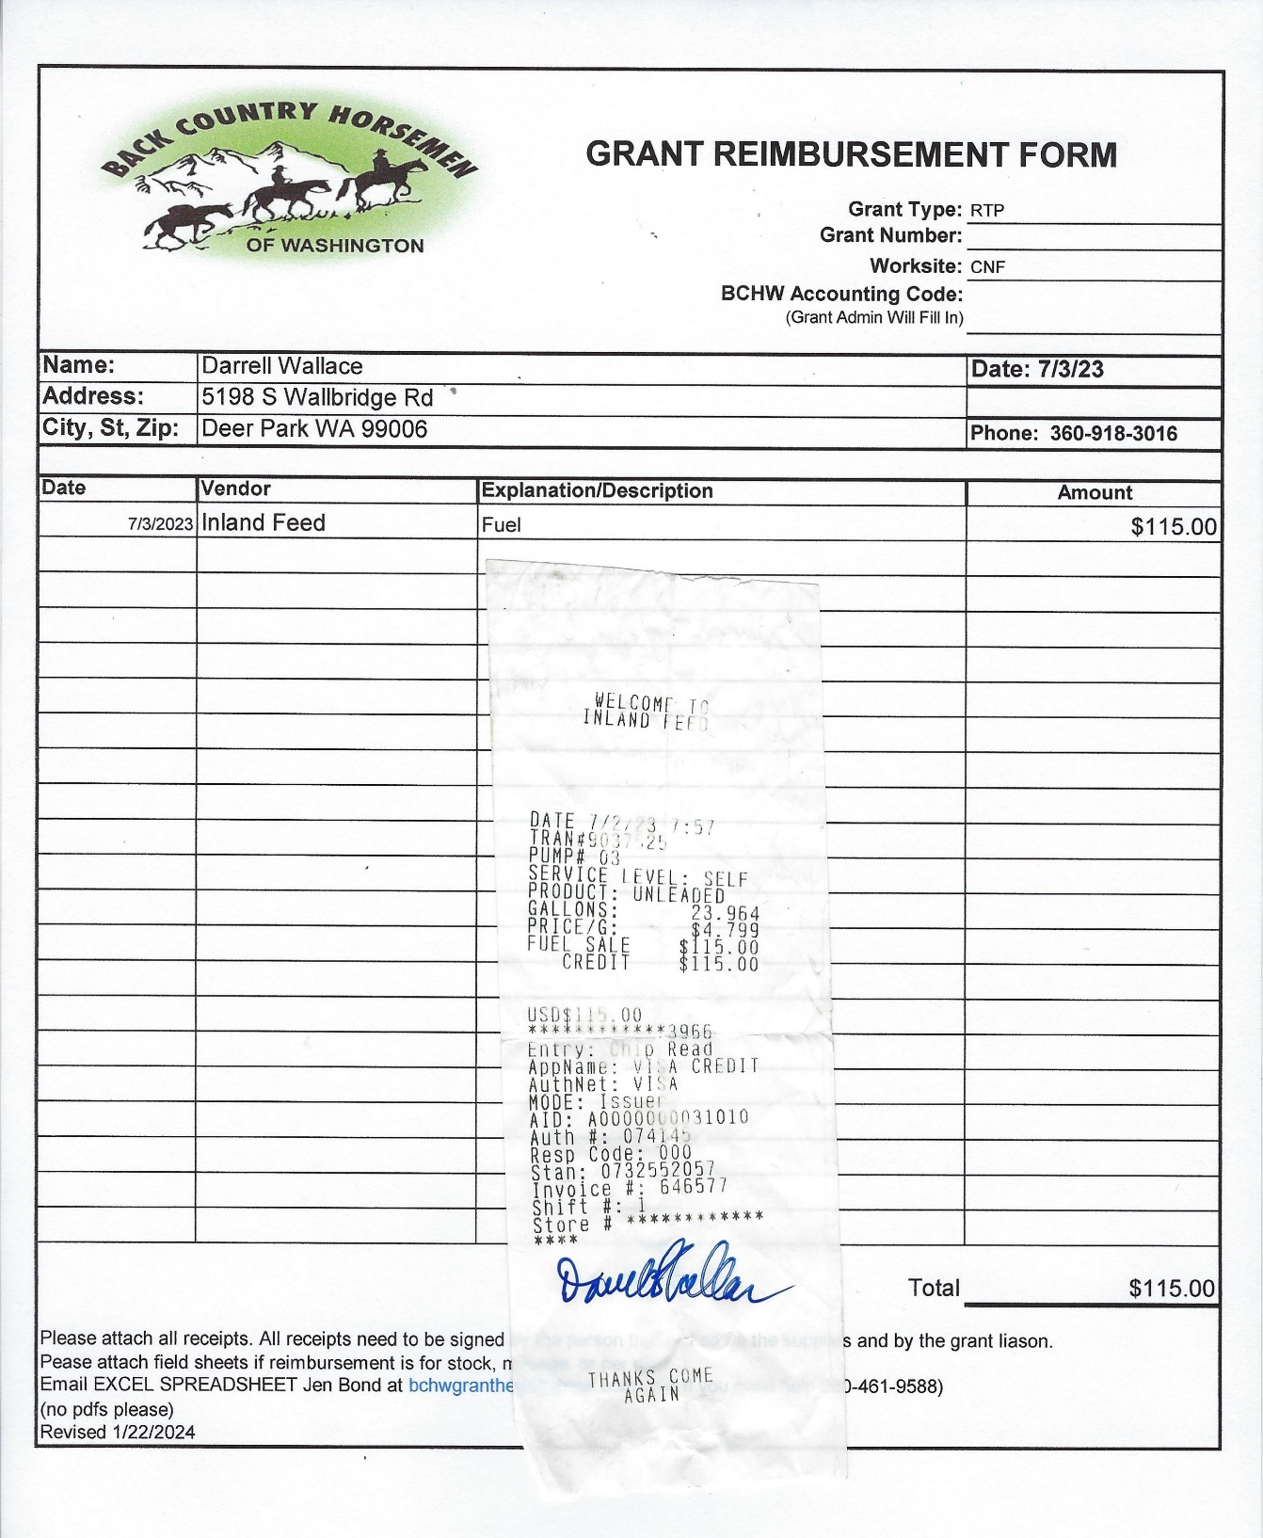
Notes:
Jen

Slide 12
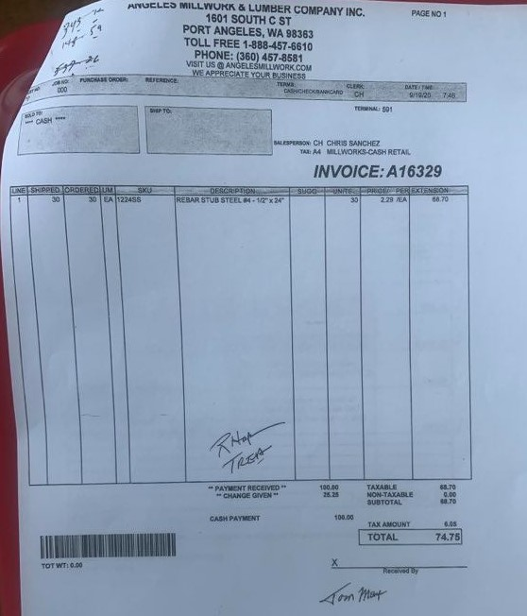
Receipts & Invoices
Vendor name
All receipts need two signatures
Person picking up/receiving item(s)
2nd signature should be grant/project liaison
Receipts need to have a date, amount, vendor name.
Do not include personal items on the receipt (especially liquor).
Grant Administrator can sign a receipt if needed.
All receipts need accompanied to the reimbursement form if requesting reimbursement.
Two signatures
Notes:
Jen

Slide 13
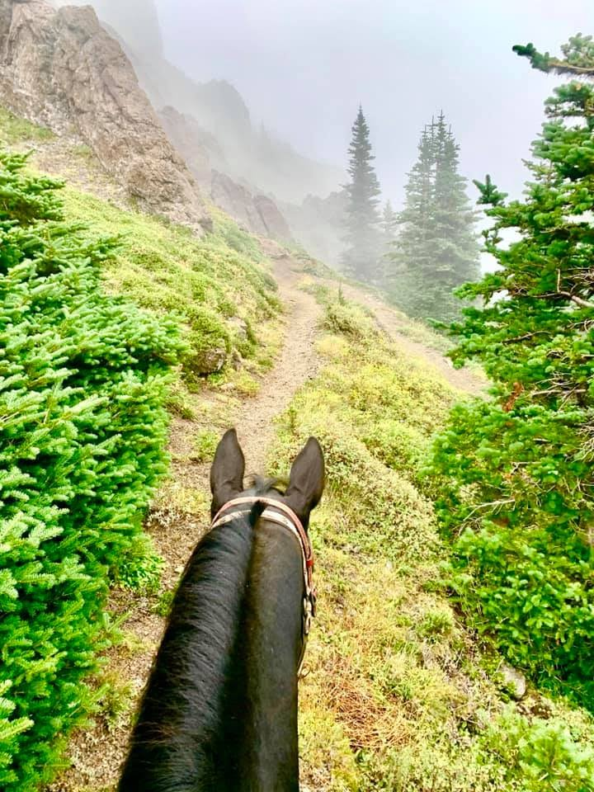
Documentation – Who Wants What?
Each grant source has certain documentation requirements (on next slide).
Each land manager has certain documentation requirements.
BCHW has certain requirements.
Tricky to create 1 form (field sheet) that meets all these requirements.
Bottom Line – Grant Administrator is flexible and will adopt to meet your chapter’s needs BUT also must ensure all grant, land manager, and BCHW requirements are being met.
Notes:
Jen

Slide 14
List of Requirements Per Organization
RCO Requirements
Crew leader signature & phone number
Volunteer names
Dates
Basic labor hours
Skilled occupation & hours (if any)
Site
Mileage & verification
Report Metrics
Forest Service Requirements:
Volunteer names, signature & phone #
Photo waiver
Site
Dates
Site (District or NF)
BCHW Requirements:
Name
Dates
Liability Waiver signature
Tailgate Safety documentation
Notes:
Jen - ask for Reimbursement questions here

Slide 15
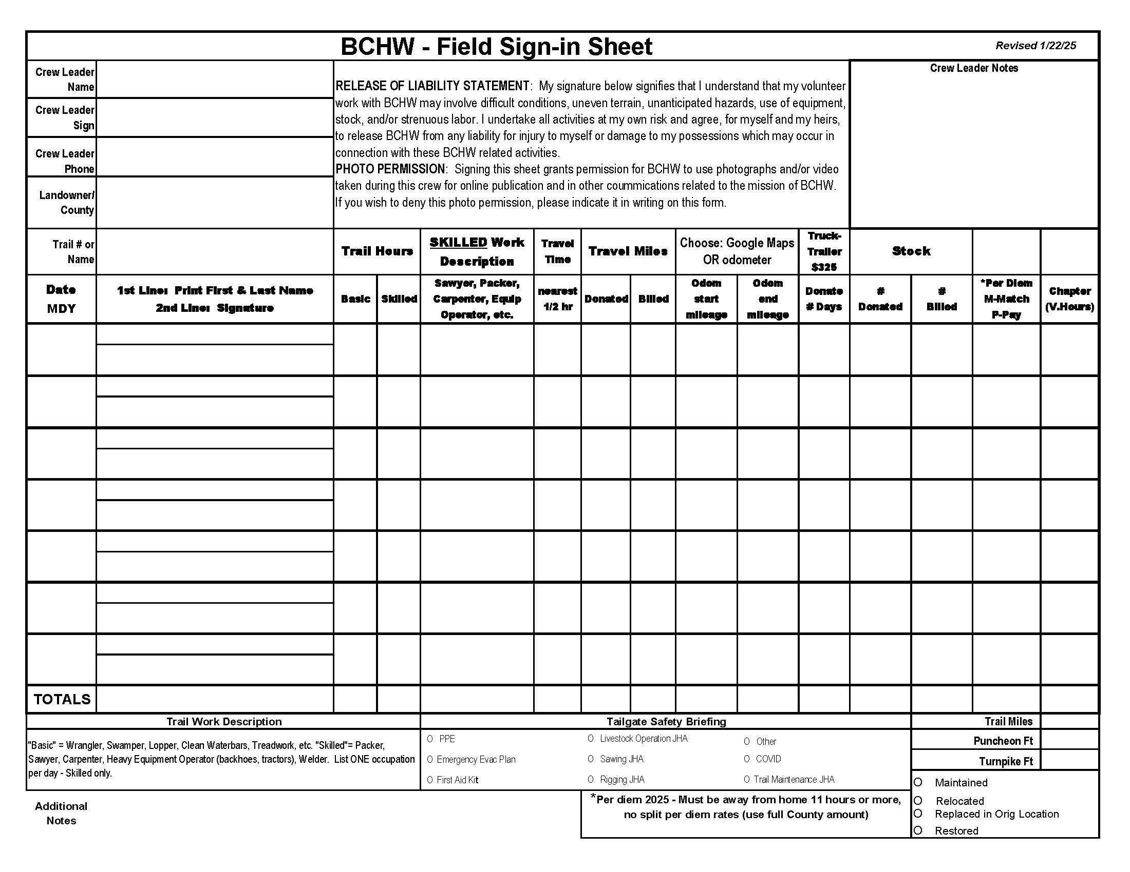
Field Sheets
Ensure you are using the correct 2025 Form (visit BCHW.org/Secure/Grants)
Field sheet needs to be completed before sending to BCHW grant administrator.
Field sheets must be included with Reimbursement Form if items on field sheet are being reimbursed (example – reimbursement for per diem, mileage, stock days).
Notes:
Jen

Slide 16
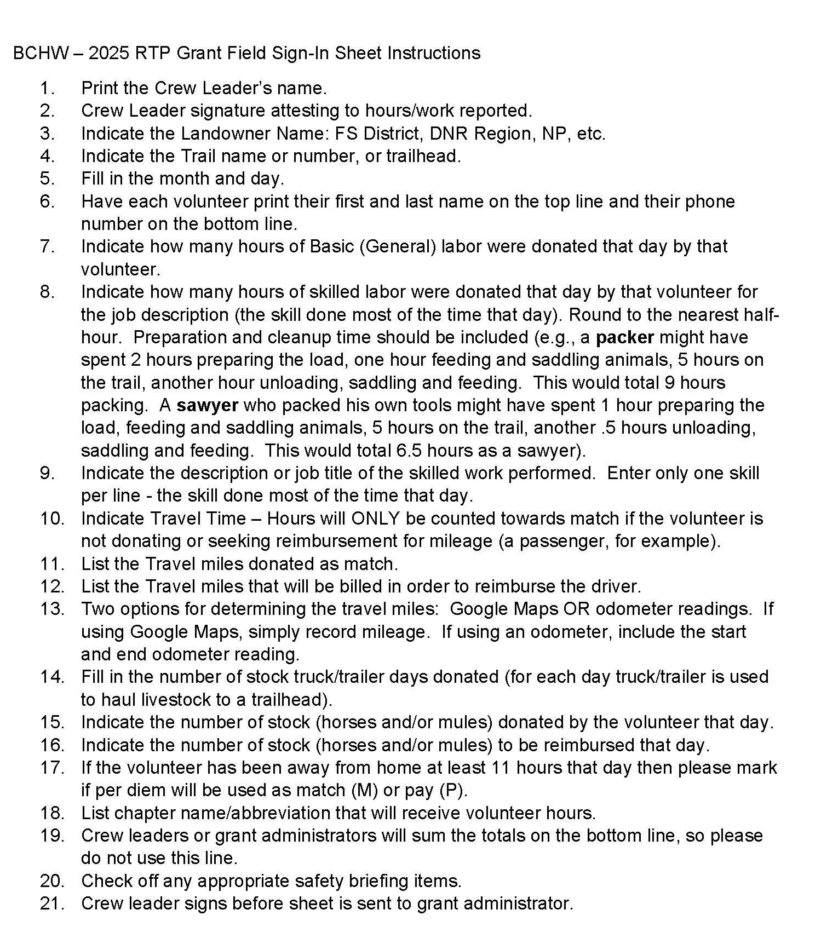
2025 Field Sheet Instructions
1.
2.
3.
4.
17.
18.
5.
6.
7.
8.
9.
10.
11.
12.
13.
14.
15.
16.
19.
20.
Notes:
Jen - ask for Field Sheets questions here

Slide 17
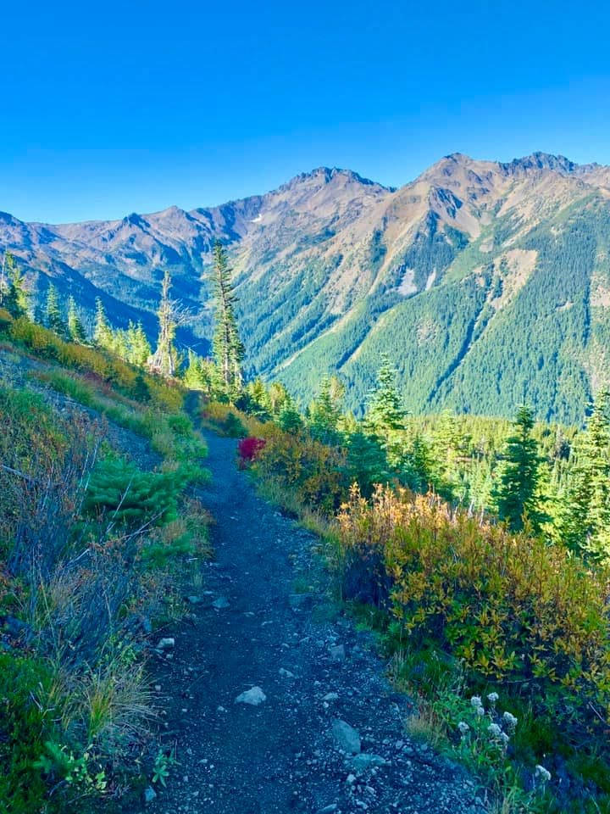
W-9 & 1099 Forms
W-9 Requirements – Chapters are required to turn in W-9 forms, at the beginning of each calendar year, for each volunteer that may be reimbursed for stock days and/or POV.
BCHW will provide 1099 Forms to volunteers per IRS requirements.
Notes:
Jen

Slide 18
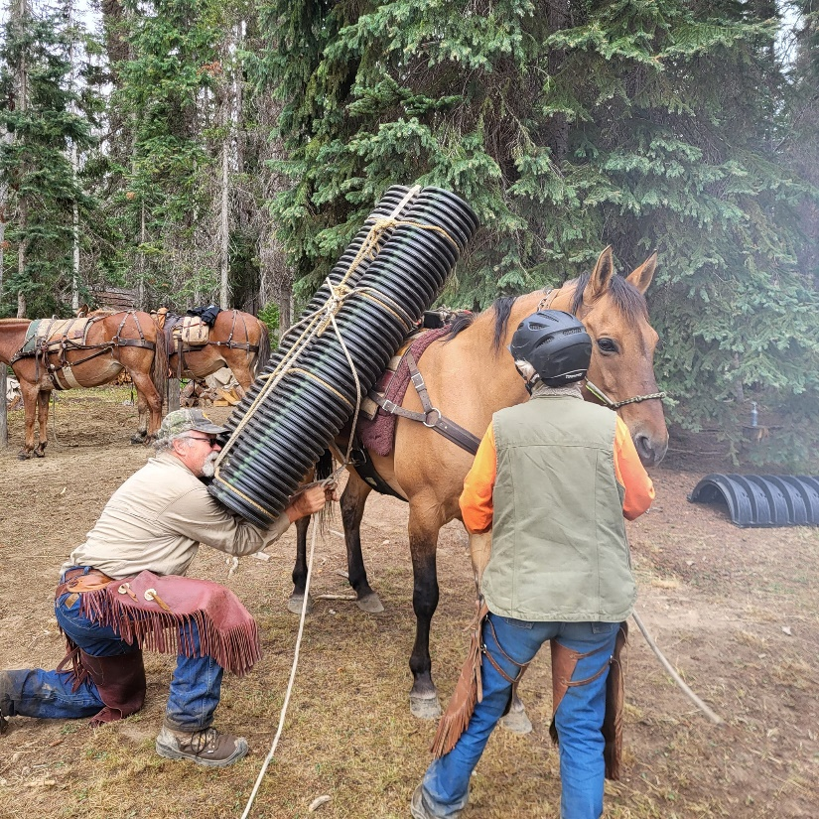
Using BCHW Credit Cards for Grants
Before purchase, ensure that the item(s) to be purchased WILL be allowable for grant reimbursement (call/email grant administrator if unsure).
Email grant administrator copy of the invoice, with signature, within 48 hours of making the credit card purchase.
In email, include the first & last name on the BCHW credit card used to make the purchase.
Grant administrator will record the charge and email the invoice to BCHW treasurer.
Another option is to ask grant administrator to make the purchase using their BCHW credit card.
Benefits of credit card purchases: saves BCHW on check fees, easier to track purchase, volunteer/chapter does not have to wait weeks for reimbursement
Notes:
Jen

Slide 19
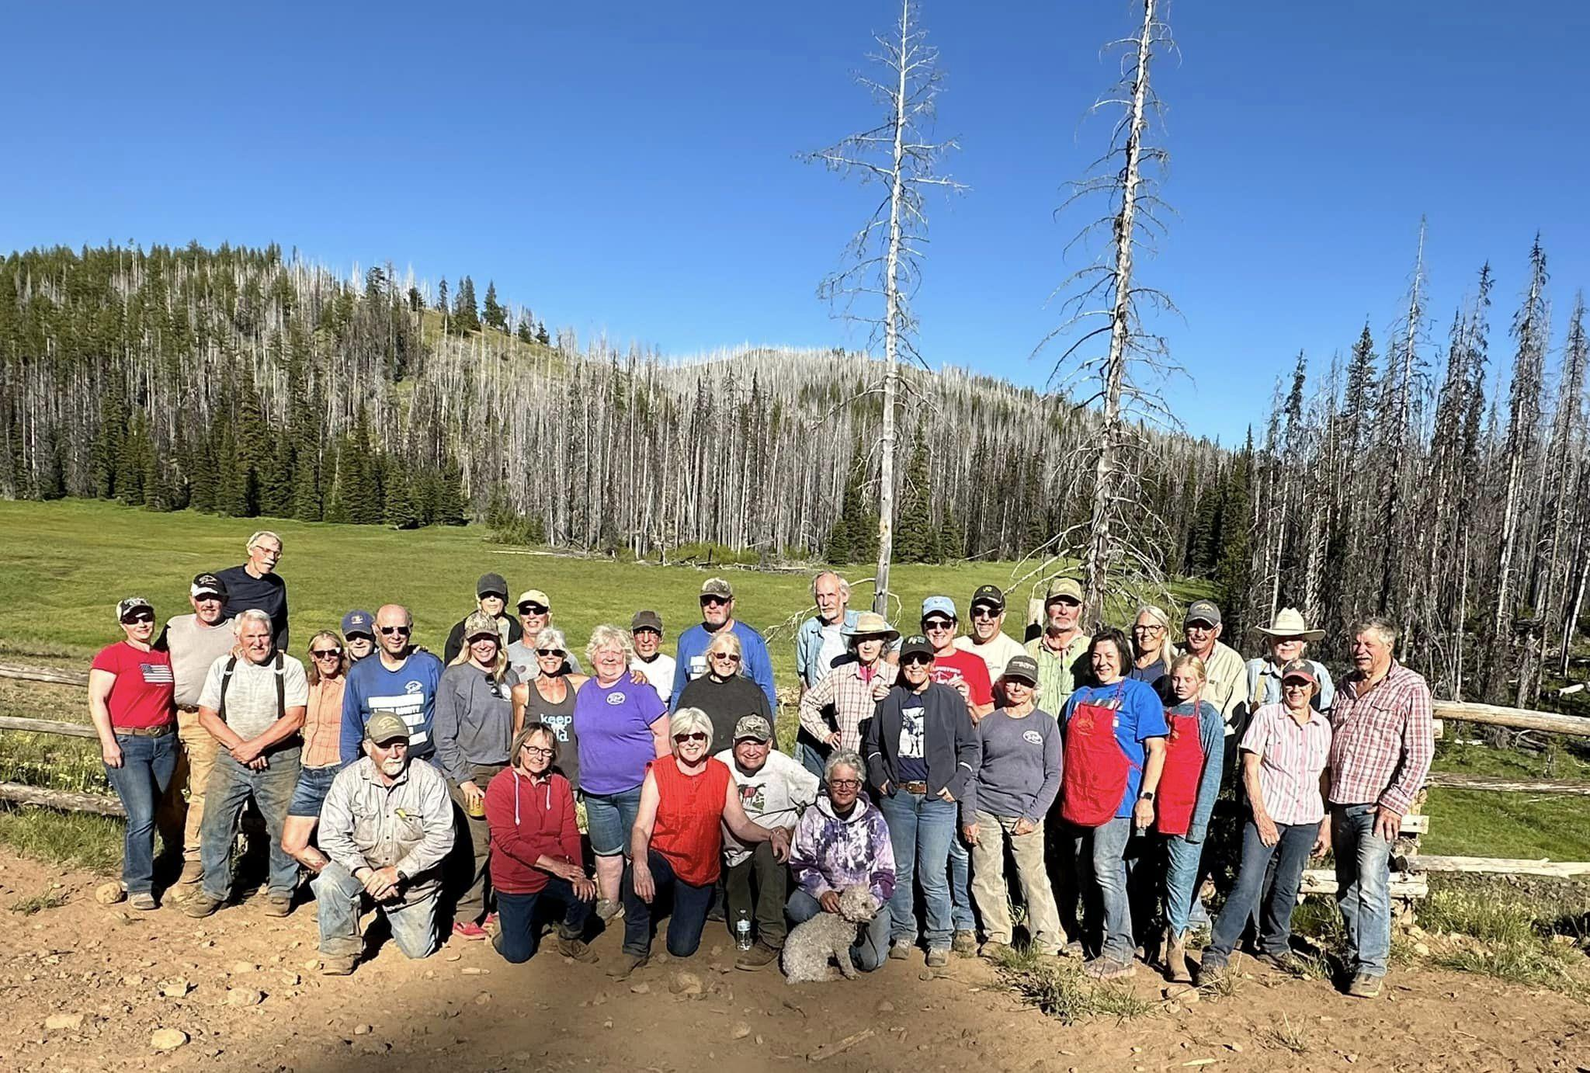
Using BCHW Credit Card to Buy Fuel:
IF you use BCHW credit card to buy volunteer fuel then mark “R” or “Receipt” on Field Sheet
Note - this means that you must turn in a field sheet if you are also turning in fuel receipts
1 receipt for each volunteer/vehicle (don’t pump multiple vehicles with same transaction)
Notes:
Jen/Darrell

Slide 20
What is Match & Why Is It Important?
Most grant funding agencies require project sponsors (us) to kick in money when using grant funds to complete projects.
Match Ratio – The amount of match a project sponsor is required to provide. A 1:1 ratio means we have to provide $1 dollar of match for every $1 a funding agency reimburses to us. A 2:1 match ratio means we have to donate $2 for every $1 they reimburse to us.
Failure to donate the required match amount means that the funding agency will not provide us the full grant amount.
Sometimes funding agencies require cash match, which is exactly that, cash that you must donate to a project. This isn’t ideal for cash-strapped non-profits.
Most funding agencies allow us to use donated labor, equipment, and materials to serve as match.
Careful documentation is required to prove that we have donated the required match to the project.
Notes:
Darrell

Slide 21
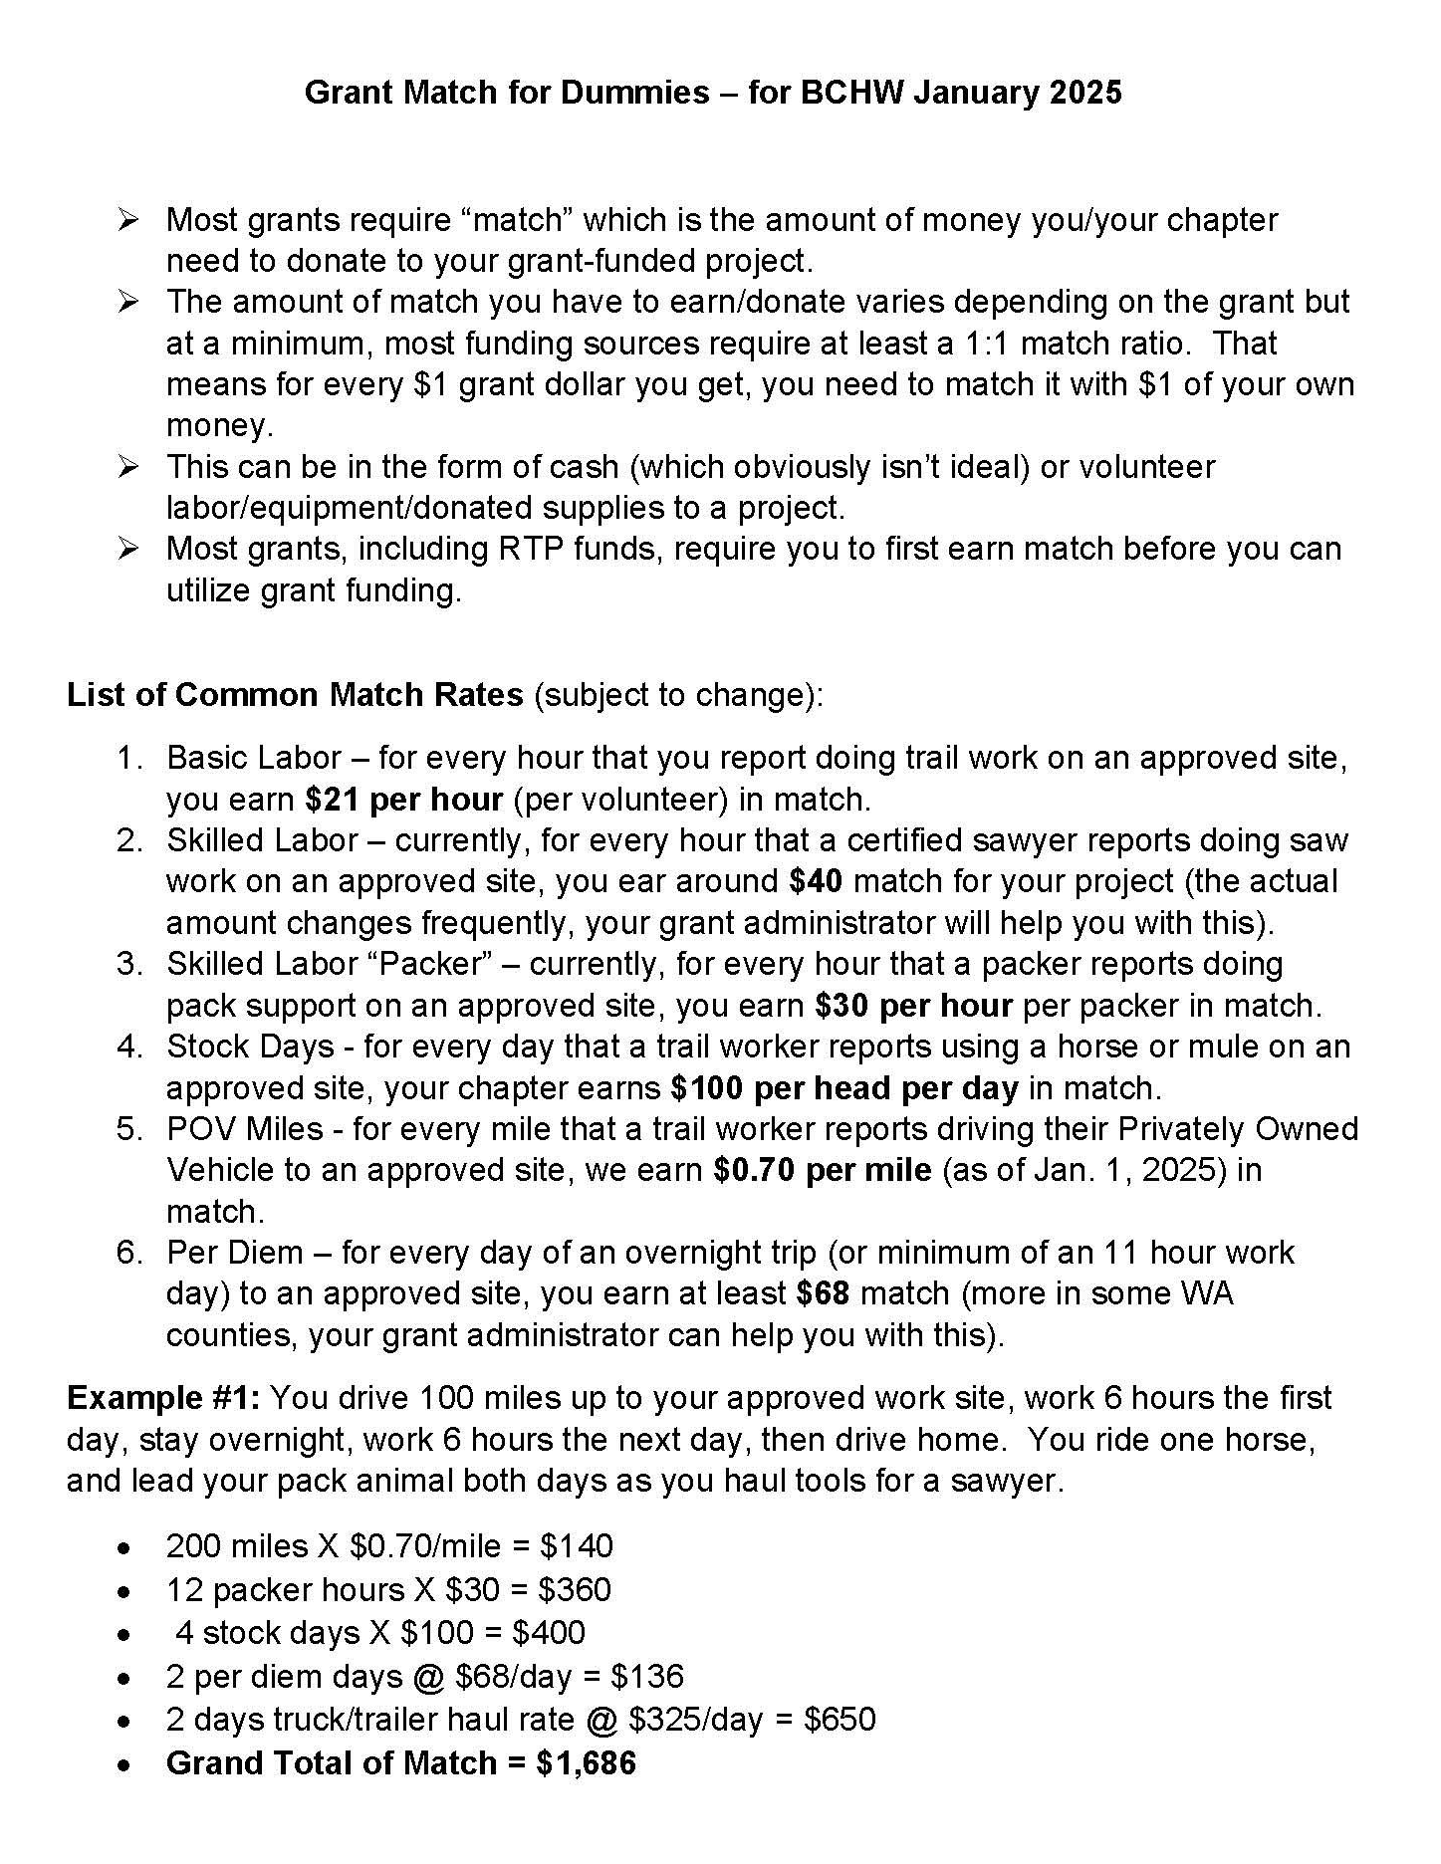
Grant Match For Dummies
This document is available on the BCHW grants webpage.
Notes:
Darrell

Slide 22
Match – What’s Eligible?
Labor – Basic or Skilled
Basic – Non-skilled labor for performing manual labor like hand removal of brush, cleaning, pruning/loping, etc.
Skilled – This is donated labor associated with a skilled occupation like sawyer, packer, carpenter, equipment operator, construction laborer. Each occupation has an hourly rate that varies from county to county and change without warning.
Stock –Stock providing trail support can be used as match at $100 per head per day.
Mileage – Travel to the project site and return to home. Sometimes volunteers opt to donate their mileage for the round trip while others may request reimbursement for one of their trips.
Per Diem – If a volunteer is away from home for 11 hours or more, then they are eligible for per diem credit. The daily per diem rate varies from county to county. Typically a portion of this per diem is donated as match (Donated) and a portion is reimbursed to the volunteer (Billed).
Truck/trailer daily rate - $325/day
Notes:
Darrell

Slide 23
Notes:
Darrell

Slide 24
Example of Donation Documentation
Notes:
Darrell - ask for “Match” questions here

Slide 25
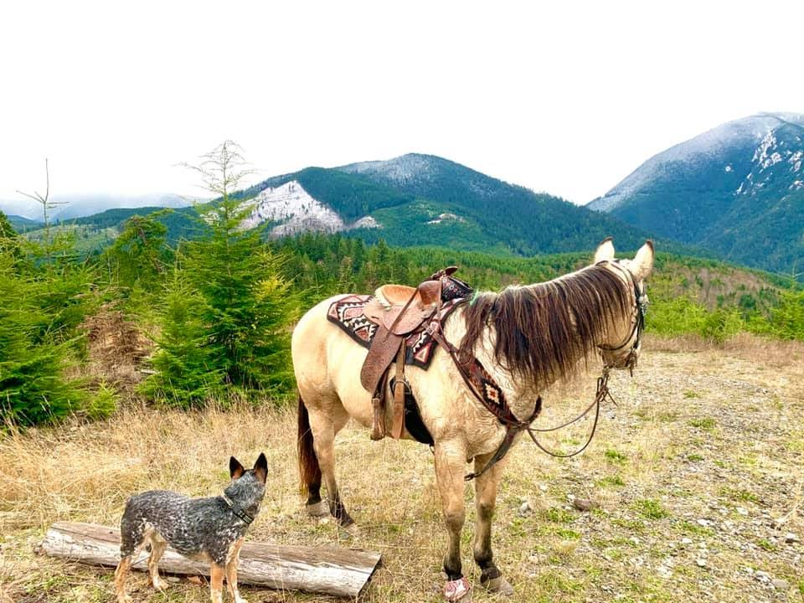
Progress Reports – Required to Get Grant $
We are required, per our contract, to provide regular progress reports on work accomplished utilizing RTP funding for each worksite in your project.
For each worksite, you need to report:
Brief description of major accomplishments during that reporting period (like a few sentences).
Include a brief explanation on any significant challenges/delays that you’re dealing with.
Brief description (again, a few sentences for each worksite) about work planned for the next reporting period.
If no work was completed during the reporting period then simply note something like “No Work.”
Metrics (next slide)
Notes:
Jen

Slide 26
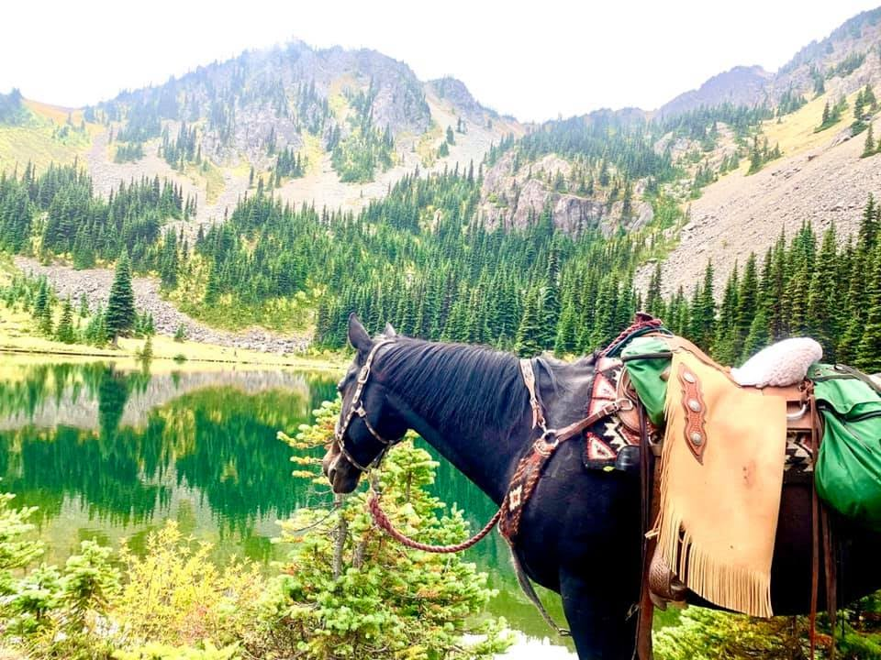
RTP Progress Reports – What to Include
The following metrics are required, by RCO, for each worksite in each progress report:
Miles of general trail maintenance
Miles of trail re-route
Miles restored or rehabilitated
Feet of puncheon, boardwalk, bridges*
Feet of turnpike*
* These two items have not been required on recent reports but have typically been required on past reports; probably a good idea to keep track of them in case they change their minds.
Notes:
Jen

Slide 27
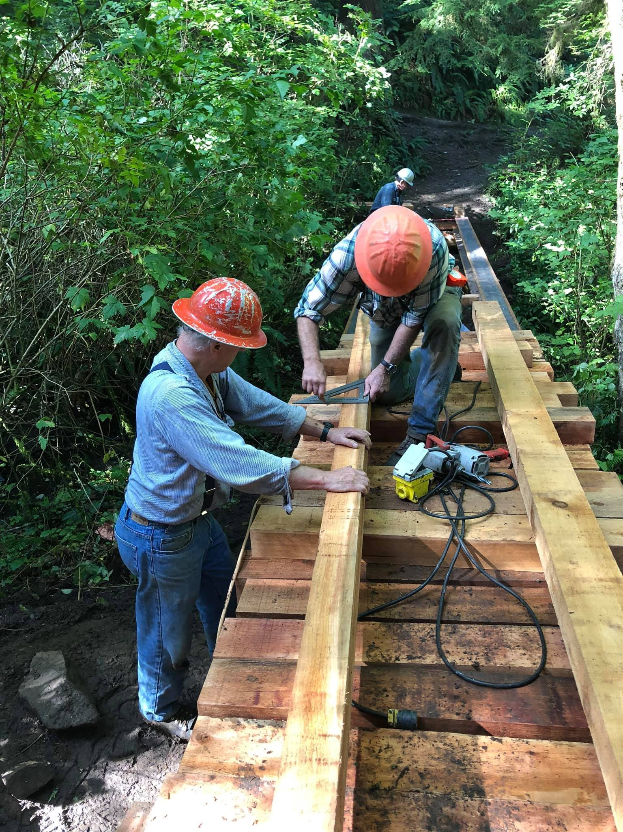
Project Photos
Photos are important (progress reports, grant applications).
Don’t need a picture from every work party but we encourage you to take photos to document work.
Some chapters post pictures on Facebook, which is really helpful for me (I search FB for pics).
Please include a brief description of where the project is located (trail name, landowner) and names of volunteers that are in the pictures (include with your FB post if posting project pictures)
PLEASE BE SURE THAT ALL SAFETY PRACTICES ARE BEING UTILIZED IN PHOTOS THAT ARE POSTED ON SOCIAL MEDIA OR SENT TO US.
Notes:
Jen

Slide 28
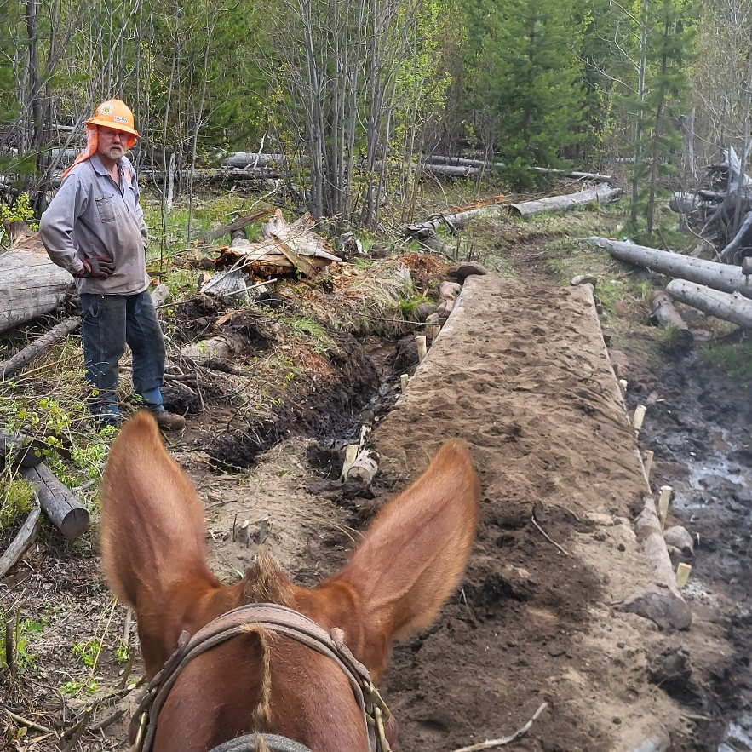
Upcoming Grant - Recreation Trails Program (RTP)
Grant limit of $150,000 per application
Minimum of a 20% match (BCHW shoots for a 1:1 match ratio)
Projects are 2 years, all public lands are eligible work sites.
Apply for grants in even years
RCO Board ranks and publishes preliminary rankings April 2025.
Project Implementation is for Nov. 1, 2025 thru Oct. 31, 2027.
Notes:
Tim

Slide 29
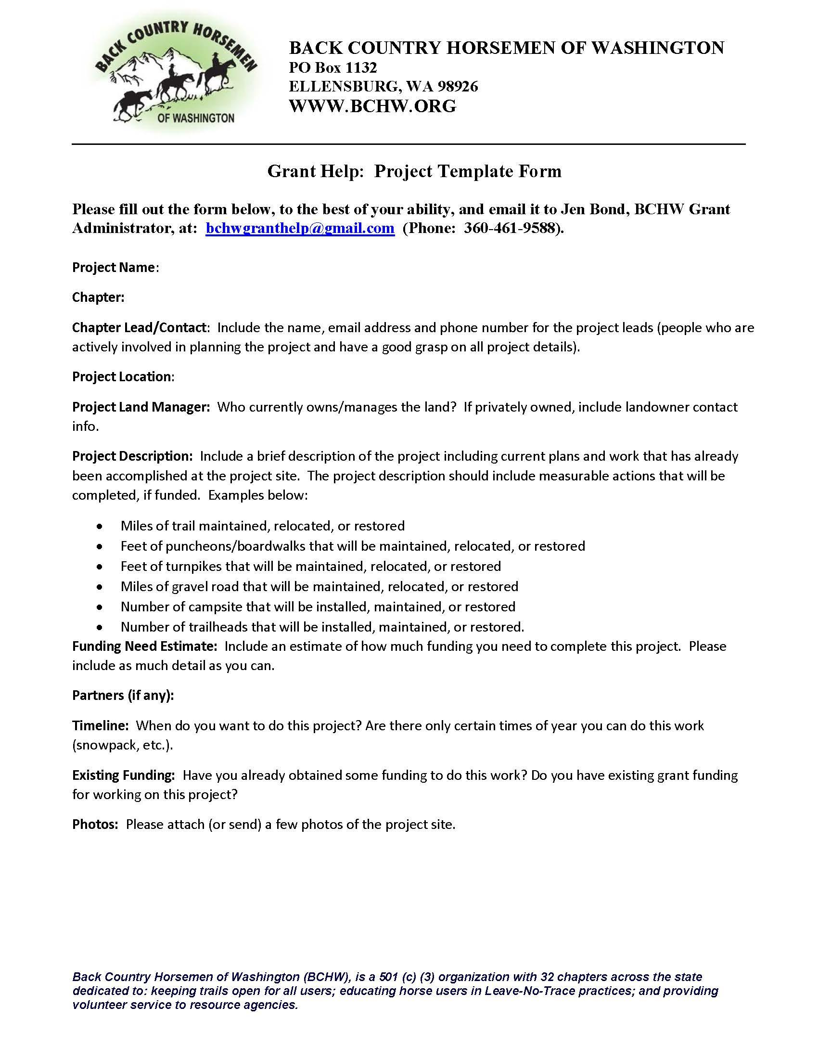
Grant Help Form
Reach out to membership & partners, what are the needs?
Develop a list of projects
Prioritize projects
Submit “Grant Help Form” to Grant Administrator get things started (overview of the project)
Notes:
Tim

Slide 30
Notes:
Tim

Slide 31
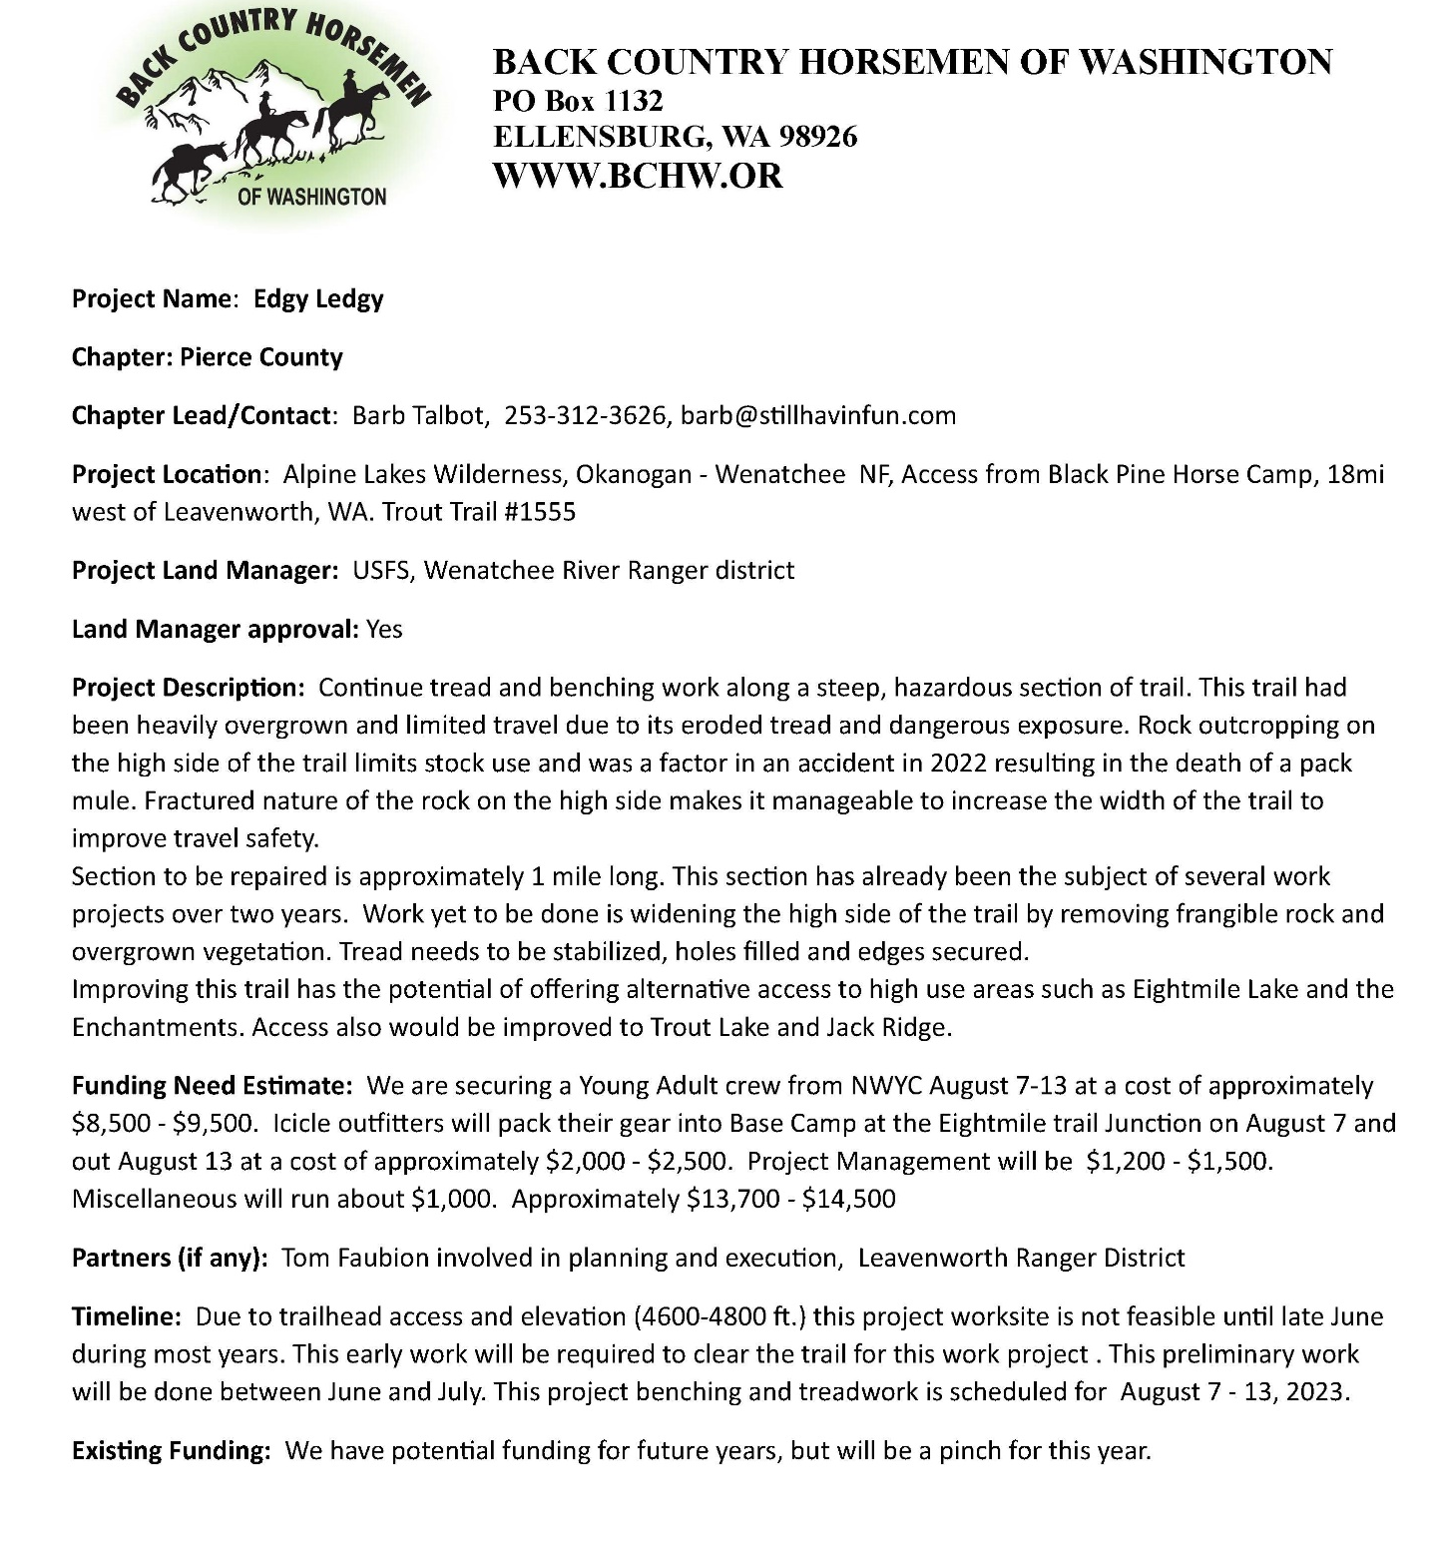
Notes:
Tim

Slide 32
Notes:
Tim

Slide 33
Help & Resources
Jen Bond, BCHW Grant Administrator
bchwgranthelp@gmail.com
Phone: 360-461-9588
Tim Van Beek, BCHW Project Manager
bchwtim@gmail.com
Phone: 360-472-5449
Darrell Wallace, BCHW Grants Committee Chair
dlwallace700@gmail.com
Phone: 360-918-3016
BCHW Website – www.bchw.org
QUESTIONS?
Notes:
All

