Slide 1
Grants 101: Using Grants to Support Trail Work
BCHW Leadership Training
February 13, 2025
By: Jen Bond, Tim Van Beek, Darrell Wallace

Slide 2
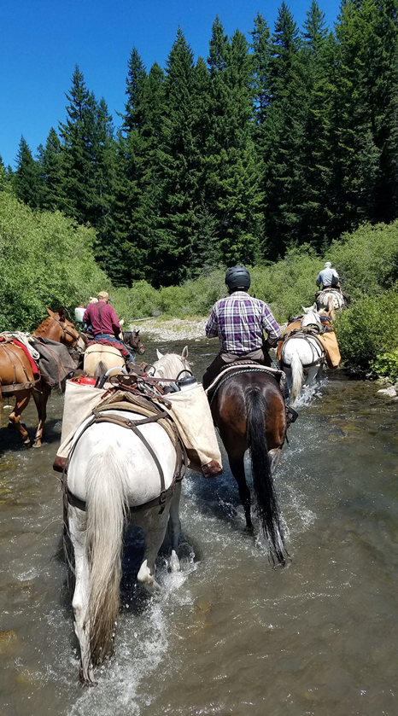
Overview
How grants can help your chapter – The obvious and not so obvious benefits of grants
Steps for applying for grants including grant writing, planning, budget development
Type of grants available
Grant Management Basics: Assuming you already have a grant…what to expect such as, forms, budgeting, reporting (more detail on grant management will be shared at the Grants 201 Training on February 18).

Slide 3
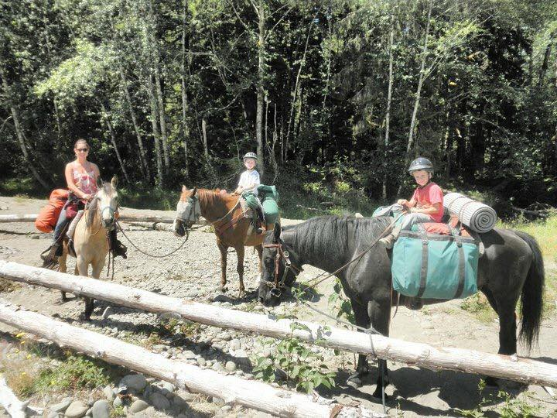
Obvious benefits of grants:
Funding to cover materials (such as lumber, gravel, tools) for completing trail projects.
Reimbursement of some volunteer expenses while working on trail projects (such as mileage).
Formalize and strengthen relationships with public land agencies and partnering volunteer groups (Forest Service, National Park Service, Washington Trails Assoc., etc.).

Slide 4
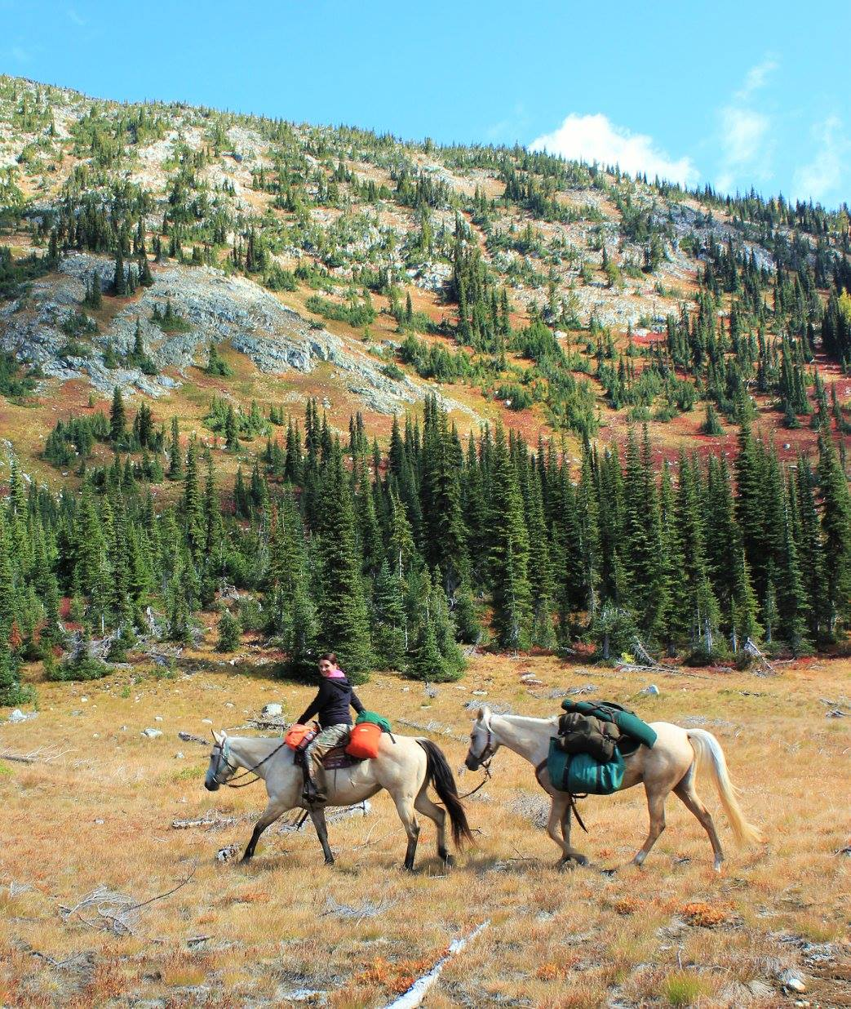
The “not so obvious” benefits of grants
Public land agencies cannot directly apply for certain types of grants and rely on non-profits (such as BCHW) or foundations to secure funding that can then be used to improve trails on public lands.
BCHW’s grant work has further strengthened our partnership with public land agencies because they rely on groups like us to leverage funding that they cannot leverage on their own.
Notes:
We all know that BCHW has proven itself as reliable partner to public land agencies but what is lesser known is that many public land agencies cannot directly apply for certain types of grants and rely on not profits (such as BCHW) or foundations to secure funding that can then be used to improve trails on public lands.

Slide 5
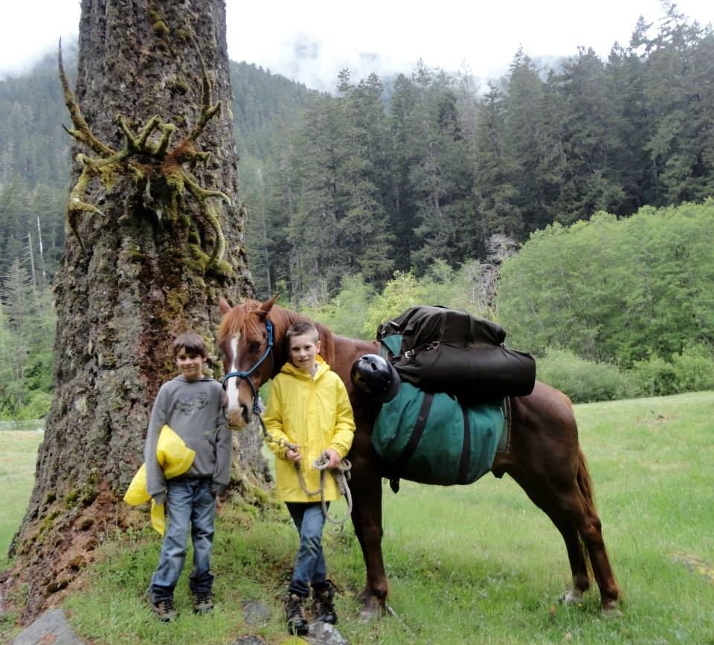
The “not so obvious” benefits of grants
Grants cover administrative and organizational expenses needed to implement the grant.
How grants pay for administrative costs varies with each funding source:
Many grant budgets will include line items to cover costs for administrating including paying the grant administrator.

Slide 6
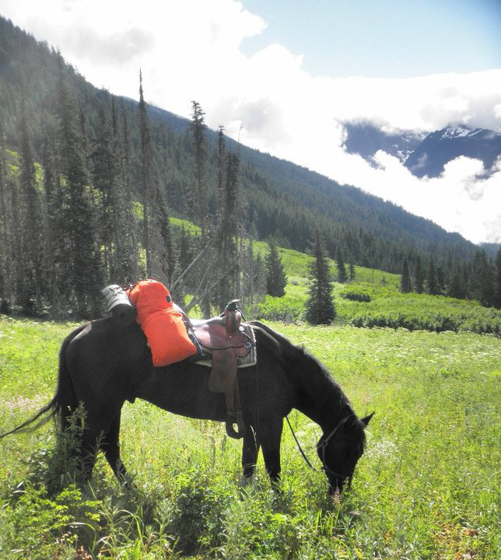
The “not so obvious” benefits of grants
Currently, grants support BCHW’s mission by covering some of the organizational expenses such as:
Equipment needed for trail work
Software, office supplies, accounting fees
Liability insurance
Trainings (sawyer certification, first aid, etc.)
Costs associated with work parties (refreshments, supplies)

Slide 7
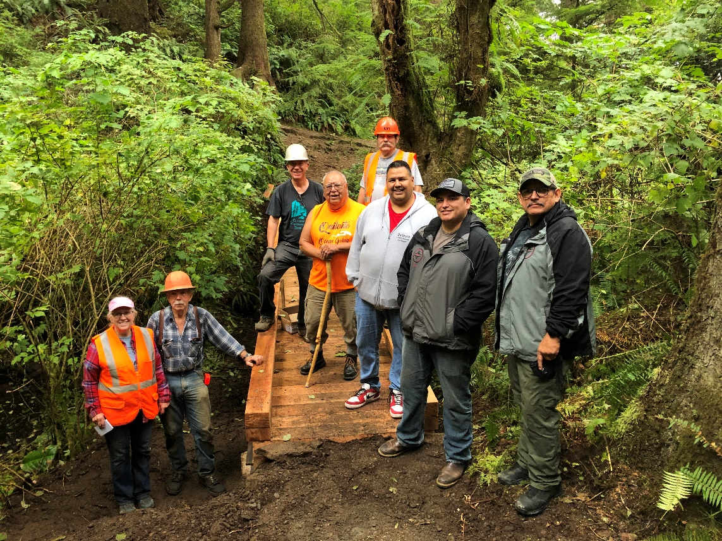
Applying For Grants - Steps
Identify & summarize project.
Develop budget for project.
As soon as you are aware of the project then contact grant administrator…don’t wait (more on this next)!
Identify grant sources that could support the project.
Apply for grants!

Slide 8
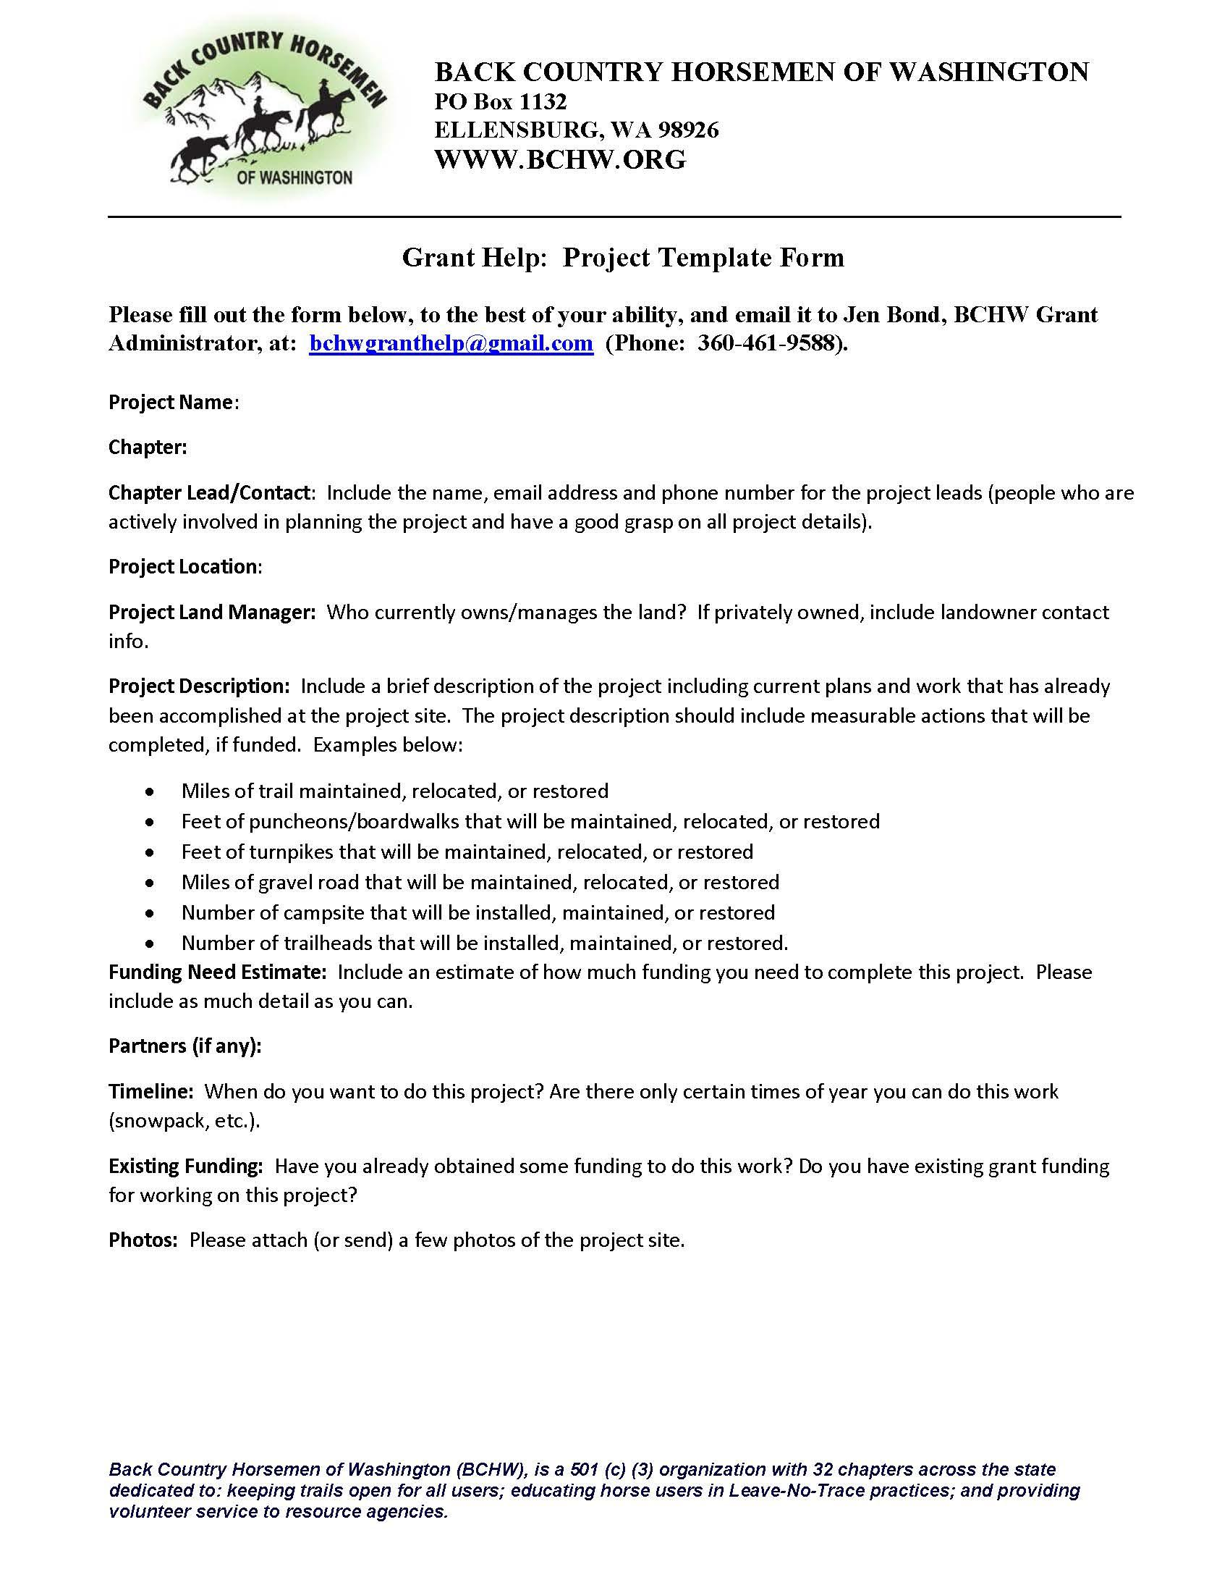
Step 1 - Identify Projects
Reach out to membership & partners, what are the needs?
Develop a list of projects
Prioritize projects
Submit “Grant Help Form” to Grant Administrator get things started (overview of the project)

Slide 9
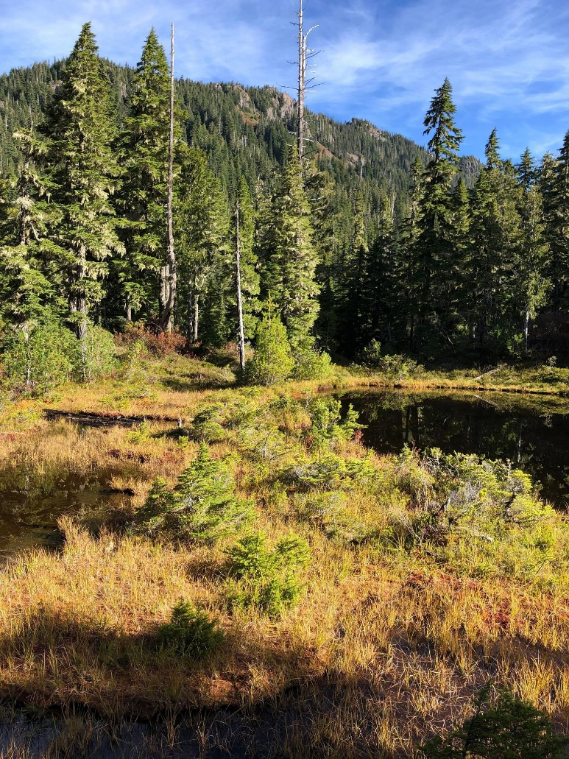
Collect Detailed Project Information:
Property/project site details
Where will the project take place (map is helpful)
Who is the property manager, include contact details
Project description of the work to take place
Who is doing the work (volunteers, hired trail crews, partner groups)
What type of work will be performed?
Project Cost/Budget
How will you generate required match for your project?
Do you need to purchase materials, supplies, or tools to complete the project? If so, cost estimate.

Slide 10
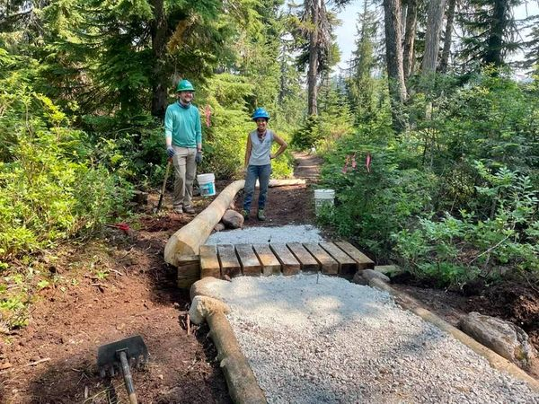
Step 2 - Develop a Budget
What are the “hard” costs for the project?
What are the “soft” costs for the project?
Existing materials, funding, other forms of support?
Match?

Slide 11
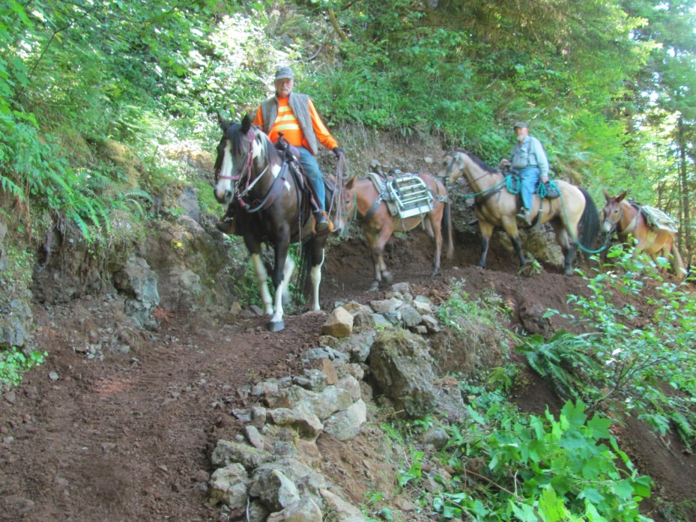
Step 3 - Identify Grant Source(s) Types of Grants Available WE CAN HELP YOU FIND A GRANT SOURCE, BELOW ARE JUST SOME OPTIONS
Recreational Trails Program (RTP)
To keep trails open and/or education
Applications due November 1 on even numbered years.
Next opportunity will be in Fall 2026
National Wilderness Stewardship Alliance (NWSA)
To keep the Wilderness open
Applications typically due April 15th
Challenge Cost Share Agreement
Can apply at anytime
Requires close coordination with your local Forest Service Ranger District
Stewardship for Trails, Education, and Partnership (STEP): From the American Quarter Horse Association
To keep trails open and/or educate about LNT
Applications due August 1
BCHA Grant

Slide 12
Recreation Trails Program (RTP) Recreation and Conservation Office (RCO)
Grant limit of $150,000 per application
Minimum of a 20% match (BCHW shoots for a 2:1 match ratio)
Projects are 2 years, all public lands are eligible work sites.
Apply for grants in even years…that means 2026 is the next application year.
Just completed applications for Year 2024 and those projects (assuming we are funded) will be implemented Nov. 1, 2025 thru Oct. 31, 2027.
2026 applications will be implemented Nov. 1, 2027 thru Oct. 31, 2029.
Long story short, PLAN AHEAD IF YOU WANT TO USE RTP FUNDS!

Slide 13
Nation Wilderness Stewardship Alliance Grants: Trail Stewardship Partner Grants
Funding amounts generally $2,000-$30,000 per organization
No match requirements but match is encouraged
Projects are 1-2 years
Can only use funds on Forest Service lands.
Applications open – No dates published yet (contingent on federal funding)
Project implementation typically May 1 thru December 31, 2025.

Slide 14
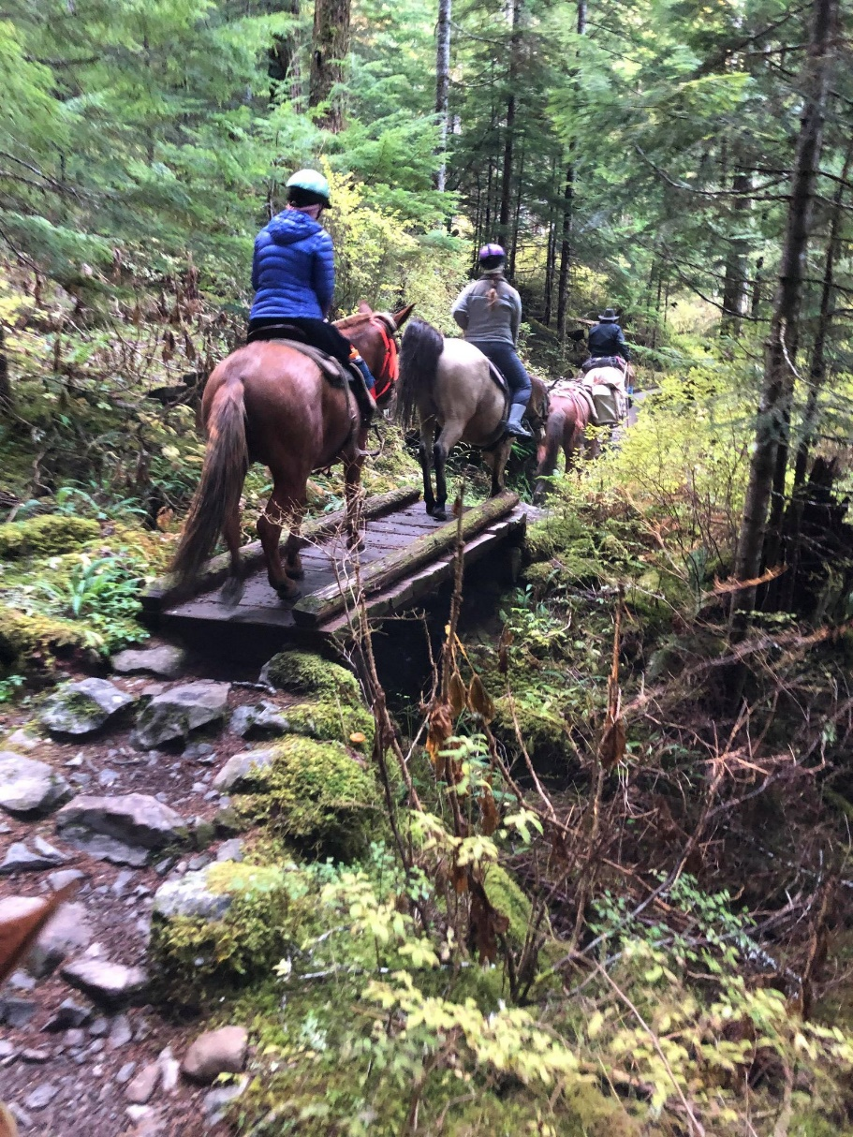
Step 4 – Apply for Grants! Grant Application: Checklist (varies depending on funding source)
Letter from the board of your chapter supporting this grant
Partner project support letter(s)
Landowner Agreement Letter (for the landowner of the project site)
Detailed information about the project (more info below)
Pictures showing what needs to be done
Maps

Slide 15
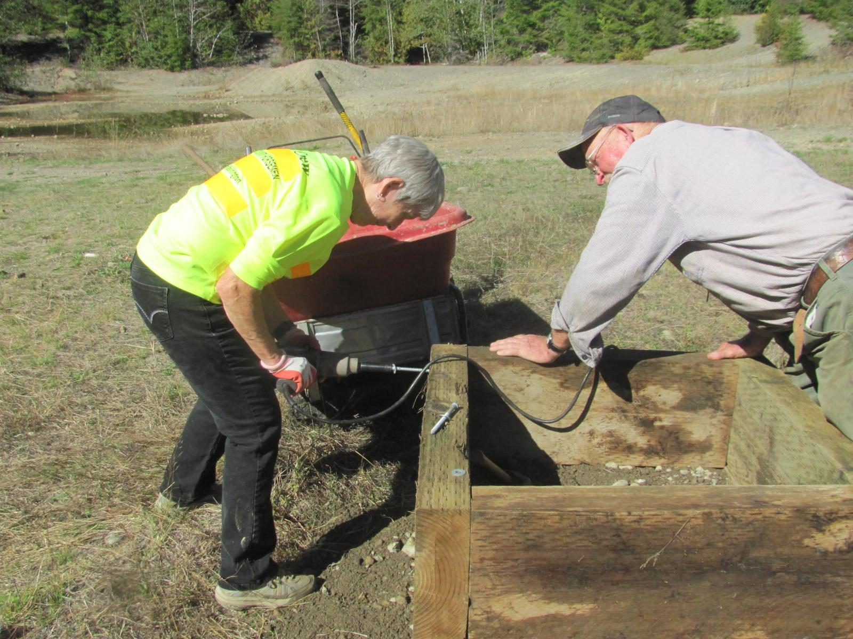
You are awarded a grant, now what?
Managing project expenses – reimbursements, documentation, etc.
Match requirements
Reporting requirements
Grants 201 Training scheduled for 6:00PM on February 18, will go into detail on steps for managing grants.

Slide 16
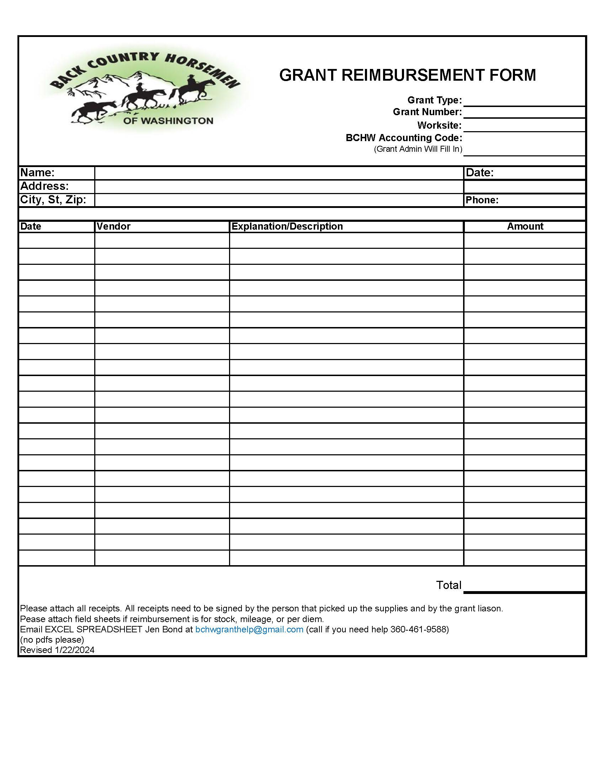
Grant Reimbursement Form
This is an Excel document and should be filled in electronically.
Send Excel spreadsheet to BCHW grant administrator (not a pdf).
Ensure all documentation like receipts/invoices are attached.

Slide 17
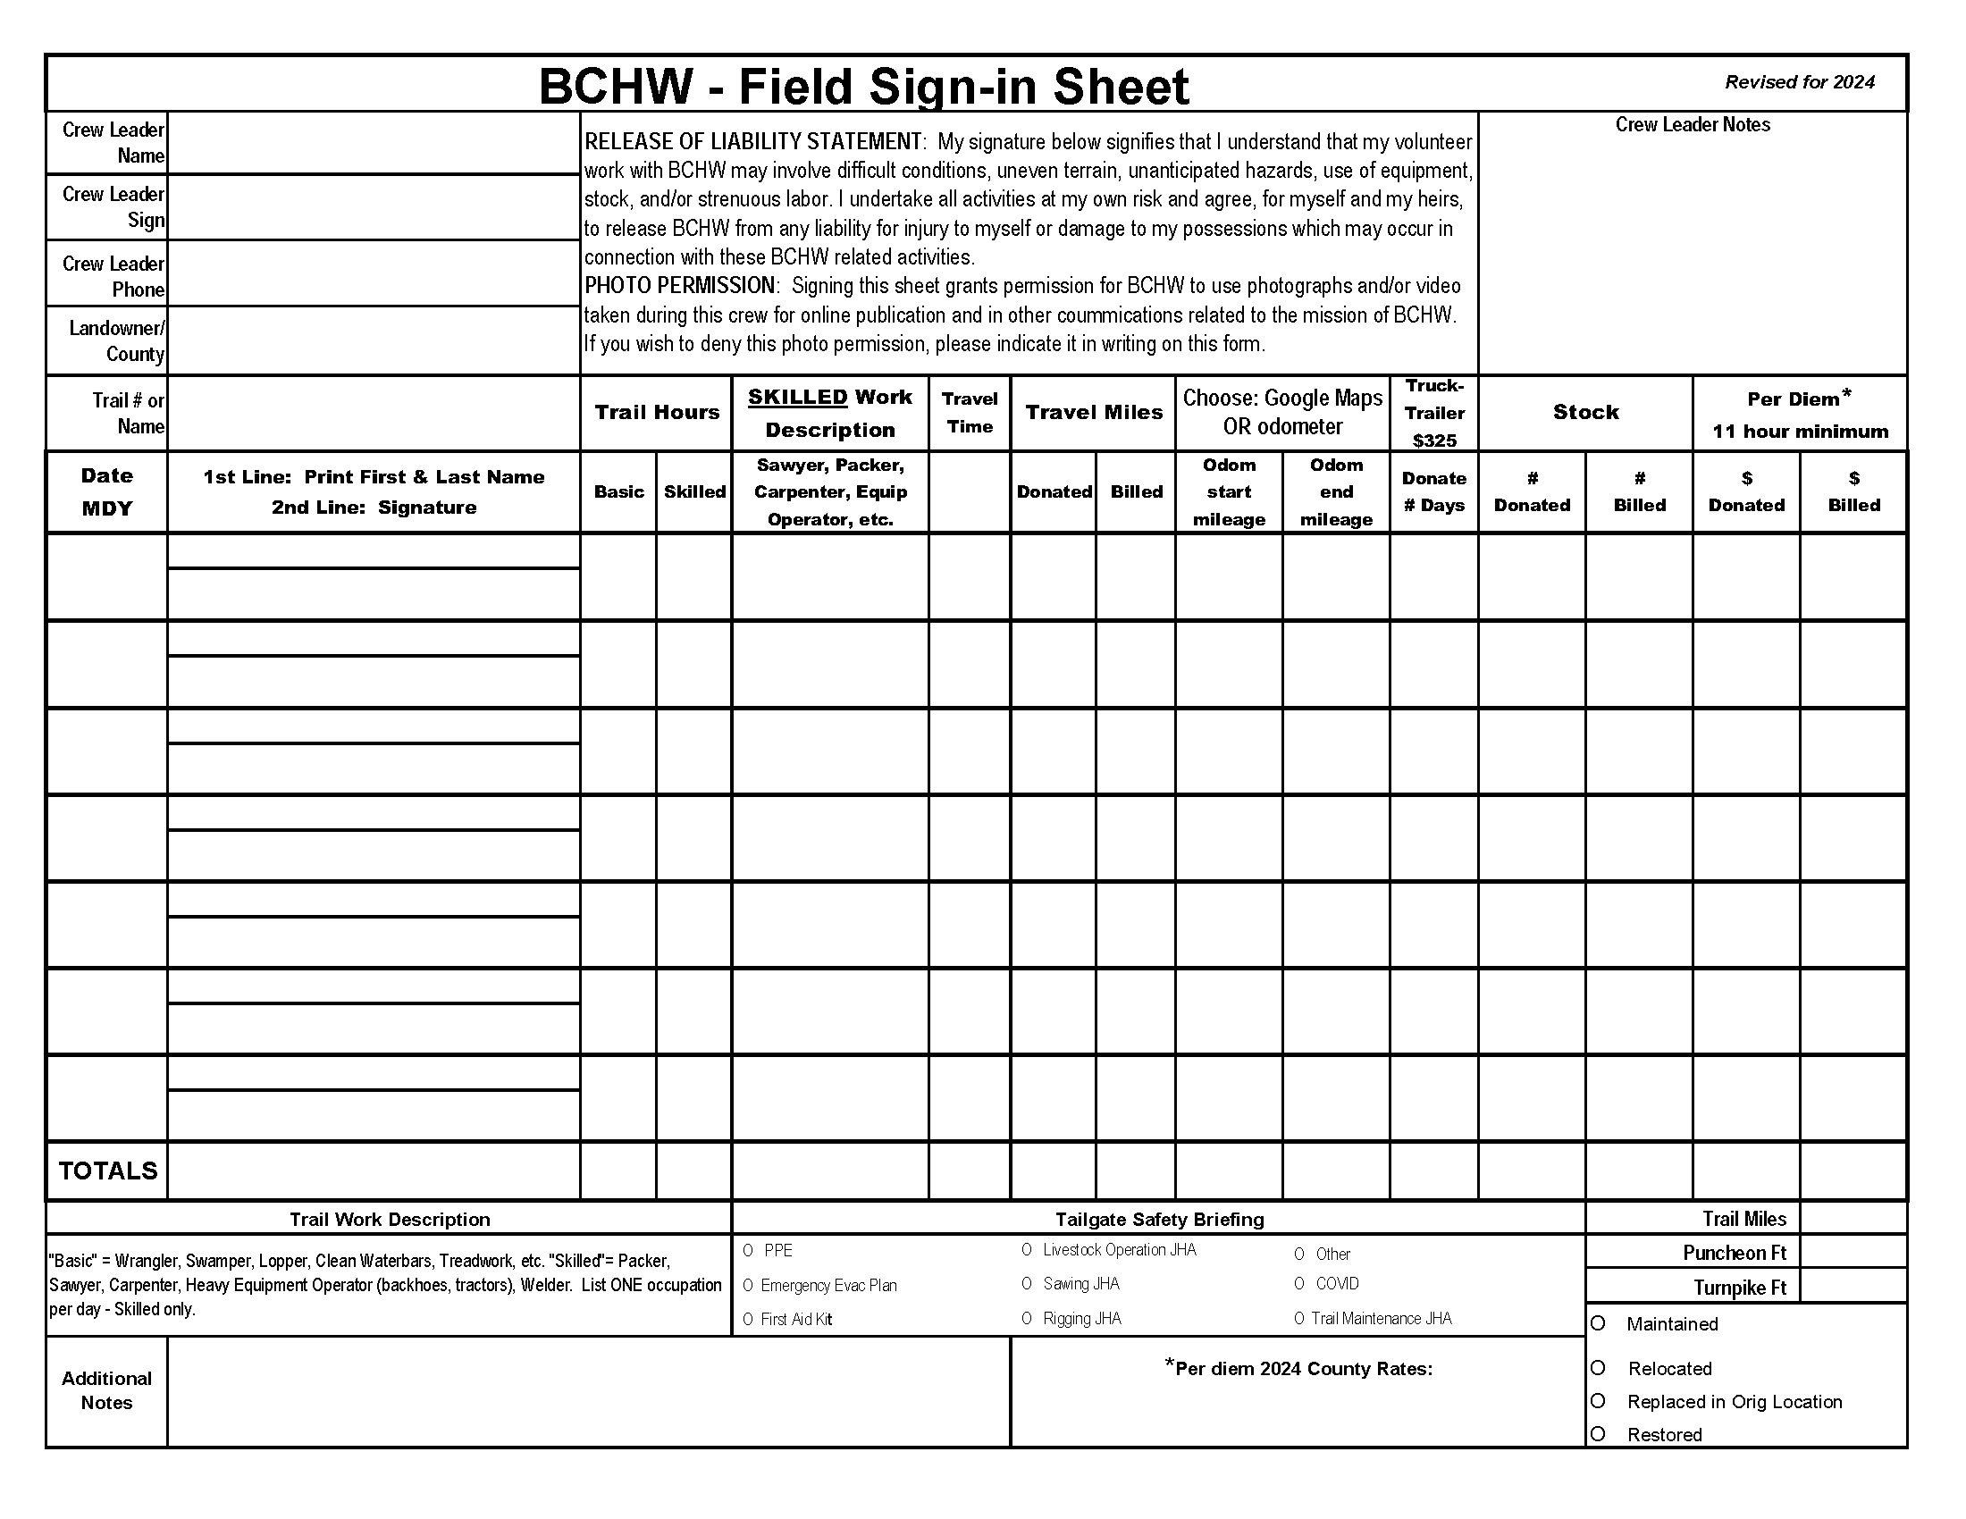

Slide 18
What is Match & Why Is It Important?
Most grant funding agencies require project sponsors (us) to kick in money when using grant funds to complete projects.
Match Ratio – The amount of match a project sponsor is required to provide. A 1:1 ratio means we provide $1 dollar of match for every $1 a funding agency reimburses to us. A 2:1 match ratio means we have to donate $2 for every $1 they reimburse to us.
Failure to donate the required match amount means that the funding agency will not provide us the full grant amount.
Sometimes funding agencies require cash match, which is exactly that, cash that you must donate to a project. This isn’t ideal for cash-strapped non-profits.
Most funding agencies allow us to use donated labor, equipment, and materials to serve as match.
Careful documentation is required to prove that we have donated the required match to the project.

Slide 19
Match – What’s Eligible?
Labor – Basic or Skilled
Basic – Non-skilled labor for performing manual labor like hand removal of brush, cleaning, pruning/loping, etc.
Skilled – This is donated labor associated with a skilled occupation like sawyer, packer, carpenter, equipment operator, construction laborer. Each occupation has an hourly rate that varies from county to county and change without warning.
Stock –Stock providing trail support can be used as match at $100 per head per day.
Mileage – Travel to the project site and return to home. Volunteers may request partial or total reimbursement for one of their trips.
Per Diem – If a volunteer is away from home for 11 hours or more, then they are eligible for per diem credit. The daily per diem rate varies from county to county and may be donated as match.

Slide 20
Grant Match For Dummies
This document is available on the BCHW grants webpage.
Example 3…may be able to claim $325 per day when hauling stock.

Slide 21
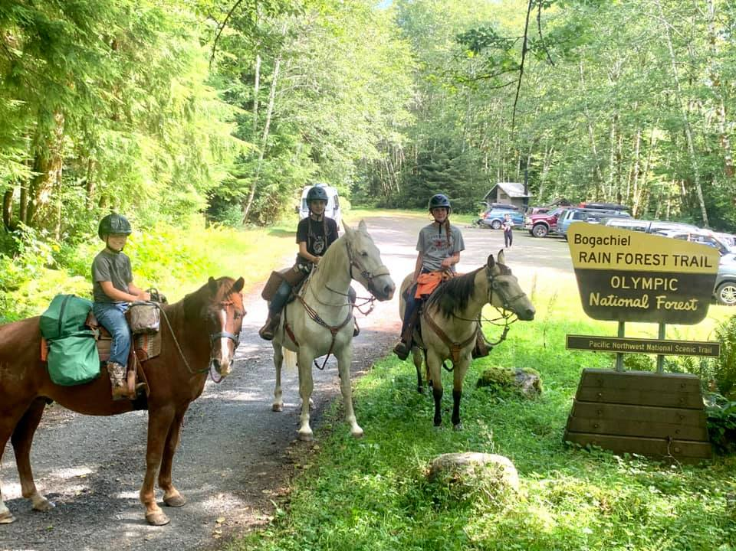
Questions?

