Slide 1
Wedges
MODULE 6
Notes:
Say:
Welcome to Module 6 of the "Developing Thinking Sawyers” course. This module is designed to give you an introduction to selecting and using wedges. Wedges provide a mechanical advantage during felling or bucking operations. Understanding the use of wedges is a key component of being a “thinking sawyer.”
Display Next Slide

Slide 2
Module Topics
Wedge Basics
Types of Wedges
Wedge Uses
Wedges in Bucking and Felling Operations
Tree Segments
Notes:
Review
Review the module topics listed on the slide.
Transition:
Let’s review the objectives we have for this module.
Display Next Slide

Slide 3
Objectives
When you complete this module, you will be able to:
Describe and discuss how wedges work.
Describe the different types of wedges.
Explain the different uses of wedges.
Explain how sawyers use wedges in felling operations.
Calculate the number of segments in a tree.
Notes:
Review
Review the objectives listed on the slide.
Transition:
Next, we will discuss wedge basics.
Display Next Slide

Slide 4
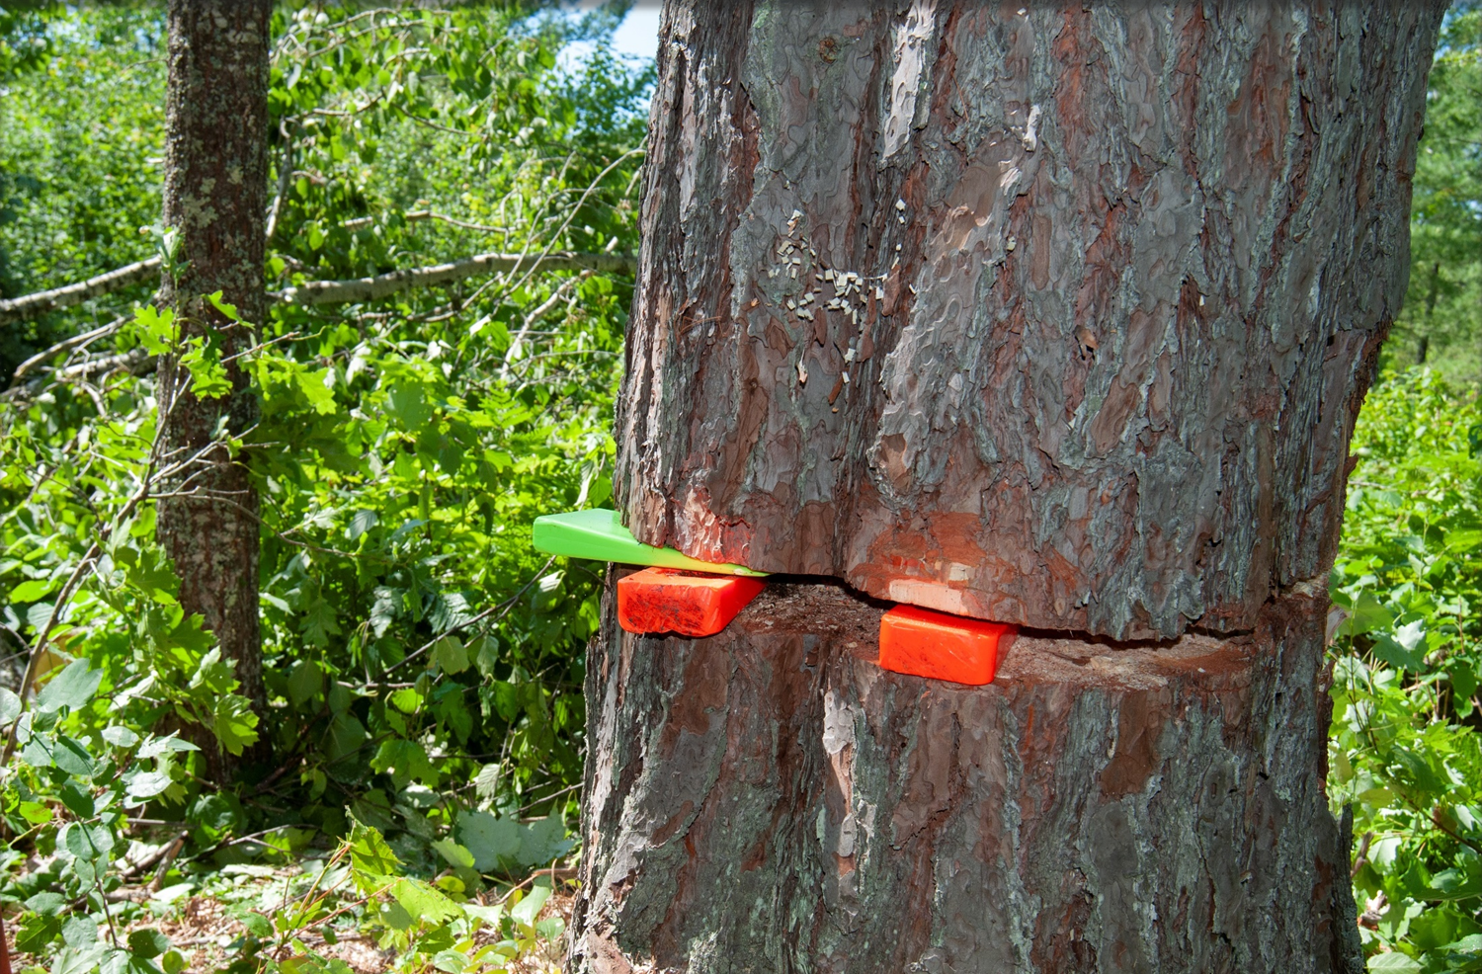
Wedge Basics
Notes:
Say:
A wedge is an essential tool for bucking and felling operations. Sawyers use wedges during bucking operations to manage compression and prevent the saw from becoming pinched or stuck in the kerf. They use wedges during felling operations to lift the back of the tree and redistribute the center weight into the undercut, and can also use wedges to support the hinge on trees with heavy side leans.
Display Next Slide

Slide 5
How Wedges Work
Notes:
Say:
A wedge is any material with a thick end tapering to a thin edge that is driven between two objects or parts of an object to secure, lift, or separate them. Wedges provide sawyers with a mechanical advantage for managing compressive forces.
Display Next Slide

Slide 6
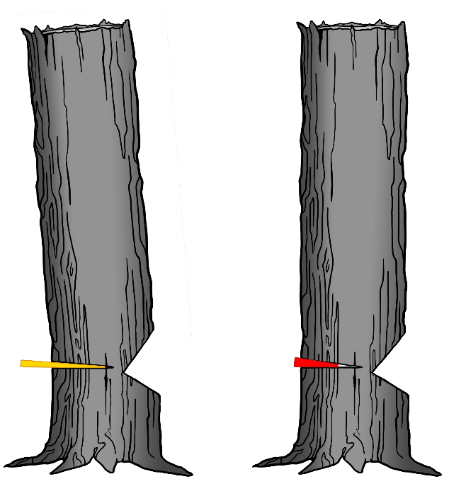
Calculating Mechanical Advantage
There are many different types and sizes of wedges. Select the appropriate wedge for the task at hand.
1- by 12-inch = 8.3 percent taper
1- by 6-inch =
16.6 percent taper
For Example:
A 1- by 12-inch wedge (longer, with a thinner taper) has a mechanical advantage over a 1- by 6-inch wedge (shorter, with a steeper taper).
A 1- by 12-inch wedge is easier to drive than a 1- by 6-inch wedge of the same material.
Notes:
Say:
Wedges come in many different types and sizes. It is important to know how to select the appropriate wedge for the task at hand. You can calculate the mechanical advantage of a wedge by dividing its height by its length. Although a short wedge with a wide angle may do a job faster, it requires more force to drive than a long wedge with a narrow angle.
Example:
A 1- by 12-inch wedge has a mechanical advantage over a 1- by 6-inch wedge. Therefore, a 1- by 12-inch wedge is easier to drive under a load than a 1- by 6-inch wedge.
The longer wedge with the thinner taper has a mechanical advantage over the wedge with the shorter, steeper taper. While the wedge with the shorter, steeper taper may open the saw kerf faster, it requires more effort to drive.
Display Next Slide

Slide 7
Types of Wedges
Notes:
Say:
Modern wedges are often made of heavy-duty plastic blends. This helps minimize any damage if the cutting teeth of the saw contact the wedge.
Wedges come in several tapers and lengths, with various features that are specific to the intended use of the individual wedge.
We will discuss the following types of wedges:
Single-taper
Double-taper
Triple-taper
Hanging
Rifled and hardhead wedges
Shims
Display Next Slide

Slide 8
Types of Wedge Tapers
Single taper
Double taper
Triple taper
Notes:
Say:
Single-taper: The single-taper wedge is a right triangle with a 90-degree angle on the back plate and three unequal sides.
Double-taper: The double-taper wedge is an isosceles triangle with two equal sides.
Triple-taper: The triple-taper wedge starts similar to the single-taper wedge, but steps up the degree of incline about half way into the taper. This works well for quicker lift on smaller trees. On heavier, larger trees it lifts slowly to get the action started, and then a quicker lift takes over. Because of the drastic change in taper, a triple-taper wedge is more difficult to drive toward the back of the wedge.
Display Next Slide

Slide 9
Hanging Wedges
Notes:
Say:
Sawyers use hanging wedges for crosscut saw operations. Hanging wedges are two wedges connected by a lanyard or cord and secured (e.g., over the head of an ax) to prevent them from dropping onto the crosscut saw and damaging it. You can use hanging wedges as a pair and drive them across the kerf at the 10 o'clock and 2 o'clock positions. This prevents a log from rolling or twisting and unintentionally pinching the saw before you fully sever the log.
When hanging wedges are not available, you can use an ax or Pulaski across the kerf to prevent the log from rolling.
DISPLAY NEXT SLIDE

Slide 10
Rifled Wedges
Notes:
Say:
The grooves in rifled wedges are designed to help keep them aligned when you stack the wedges. If you use a rifled wedge singly, the rifling can become damaged, hampering the ability to stack two rifled wedges.
Display Next Slide

Slide 11
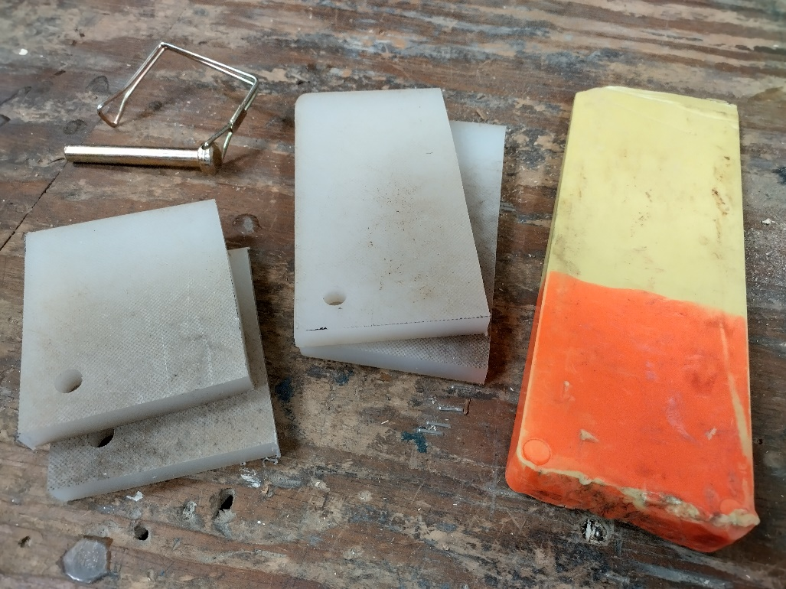
Hardhead Wedges and Shims
Notes:
Say:
Hardhead wedges have a plate of steel and metal inserted at the back of the wedge to transfer energy more efficiently. Hardhead wedges are effective for lifting large trees.
Shims
Say:
Shims are made of short sections of old wedges and are used in combination with a standard wedge. You can use them on small-diameter trees when you cannot insert two full-size wedges.
Transition:
Next, we will discuss wedge safety and techniques.
Display Next Slide

Slide 12
Wedge Safety and Techniques
General safety
Wear eye protection
Check wedges for damage
Do not use cracked or damaged wedges
Wedging techniques
Remove thick bark
Drive wedges squarely
Place wedges adjacent to each other and strike them alternately
Carry at least three wedges
Stack wedges to increase lift
Add sawdust between stacked wedges
Do not stack more than two wedges
Use a 3- to 5-pound ax of proper length
Notes:
Say:
Safety is always a priority when conducting saw operations, and this includes the use of wedges.
When using wedges in felling operations, take special care to evaluate overhead hazards, including limbs, dead or unstable tops, or loose bark. Bark can become dislodged by vibrations produced from driving a wedge.
General Safety
Always wear eye protection when driving wedges.
Check wedges for any damage before beginning a job.
Do not use cracked or damaged wedges.
Wedging Techniques
Remove thick bark before wedging to help prevent the wedge from crushing the bark instead of providing lift.
Drive the wedge by striking it squarely on the head to help prevent it from popping out. If the kerf is already under compression, drive the wedge carefully to prevent it from flying out of the kerf when struck.
Place wedges adjacent to each other and strike them alternately. This is an efficient wedging method that uses the least amount of effort.
Carry at least three wedges with you (recommended). The number of wedges you need will depend on saw operations and must be part of the wedging plan.
Stack wedges to increase the amount of lift (if necessary). It is a common practice to cross wedges to lessen the likelihood of a wedge popping out of the kerf when struck.
Add sawdust between stacked wedges to add friction and reduce the likelihood that a wedge will pop out of the kerf.
Stacking more than two wedges makes them unstable. Do not stack more than two.
Using an ax with the proper weight and handle length is imperative.
Plastic wedges can break. If you can drive a long wedge only a short way into the saw kerf, most of the wedge’s length will be exposed, and a misplaced blow can break it.
Transition:
Next, we will discuss different uses for wedges.
Display Next Slide

Slide 13
Wedge Uses
Notes:
Say:
Wedge placement is not a thoughtless process of just trying to keep the kerf open. You carefully plan wedge use and placement during the OHLEC size-up process.
Display Next Slide

Slide 14
Common Wedge Uses
Counter effects of compression
Guide trees into intended lay
Stabilization
Prevent bole movement
Indicate movement
Notes:
Say:
Sawyers most commonly use wedges to manage compressive forces in one form or another:
While bucking, you can use wedges to counteract the effects of compression by maintaining an open saw kerf.
During bucking operations, you can use hanging wedges to prevent the bole from twisting or rolling and damaging or pinching the saw.
During felling operations, you can use wedges to prevent a tree from sitting back and pinching the saw bar.
During felling operations, you can use wedges to lift the back of the tree and redistribute the center weight of the tree forward into the undercut.
During felling operations, placing a wedge loosely in the back cut can help indicate movement in the tree.
On side leaning trees, placing wedges behind and parallel to the hinge helps to stabilize the hinge and support the weight of the tree. Place these wedges snugly rather than driving them.
Display Next Slide

Slide 15
Wedges in Bucking Operations
Place the wedge in the compression zone.
Set and drive the wedge with an ax head.
Make the bucking cut.
Notes:
Say:
Place the wedge into a saw kerf in the compression zone of a log when bucking. Placing the wedge correctly is important for maximizing the mechanical advantage.
You must cut deeply enough for the wedge to fit into the kerf without contacting the saw. Set and drive the wedge by striking it with the back of an ax head. Once you set the wedge, you can complete a bucking cut without pinching the saw because the wedge prevents compression from closing the kerf.
Display Next Slide

Slide 16
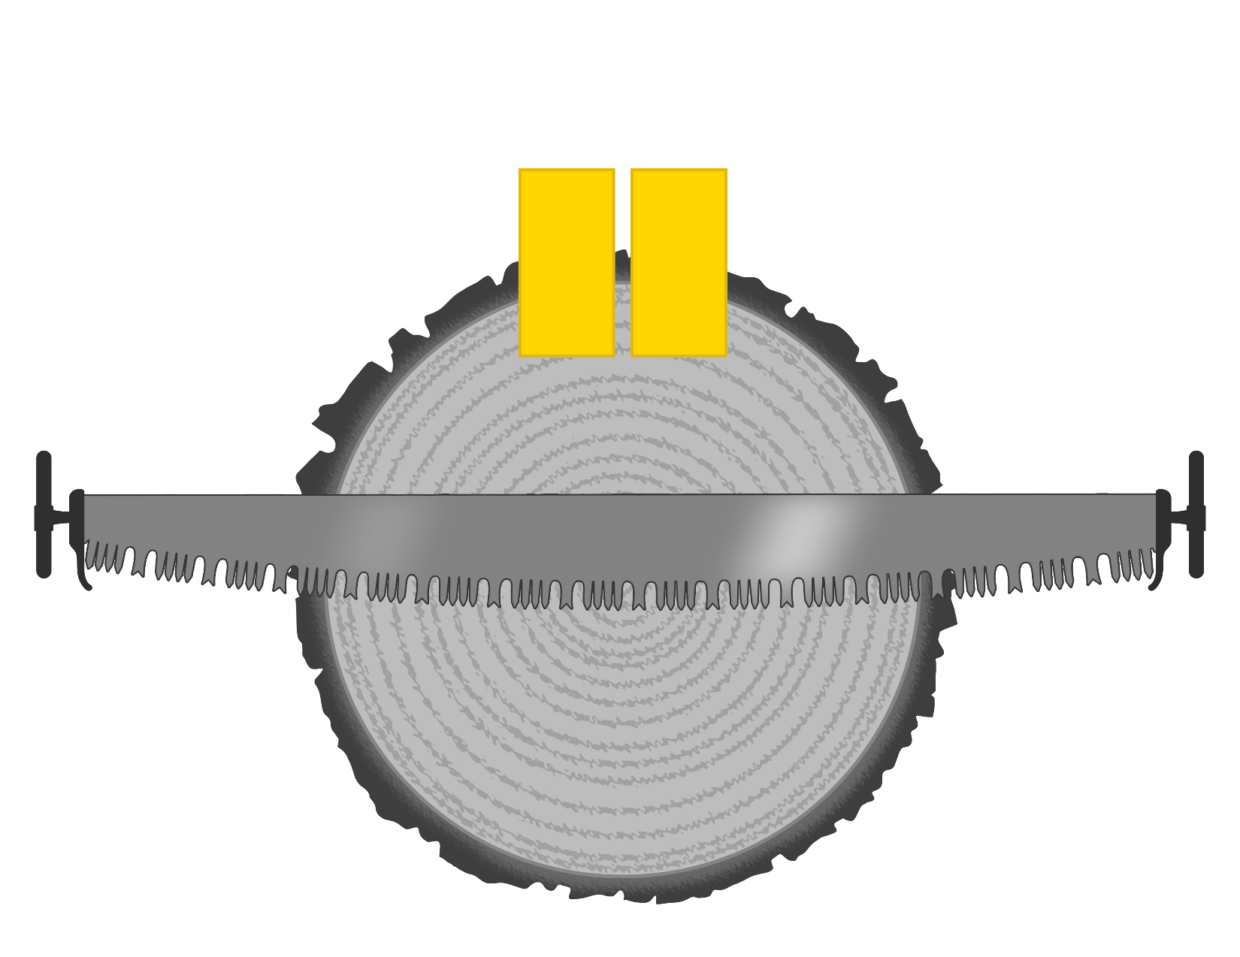
Bucking: Top Bind
Wedging technique for top bind
Notes:
Say:
In top bind situations, start a wedge as soon as you can, and add more wedges as needed. Additional wedges placed parallel to each other provide even more separating force.
Once you place these wedges, alternate striking each wedge. The kerf will open as you drive the wedges deeper, reducing the compressive forces on the other wedges. Develop an alternating pattern that enables you to drive each wedge deeper into the kerf when you strike it. You can overcome a lot of compression with this technique.
Display Next Slide

Slide 17
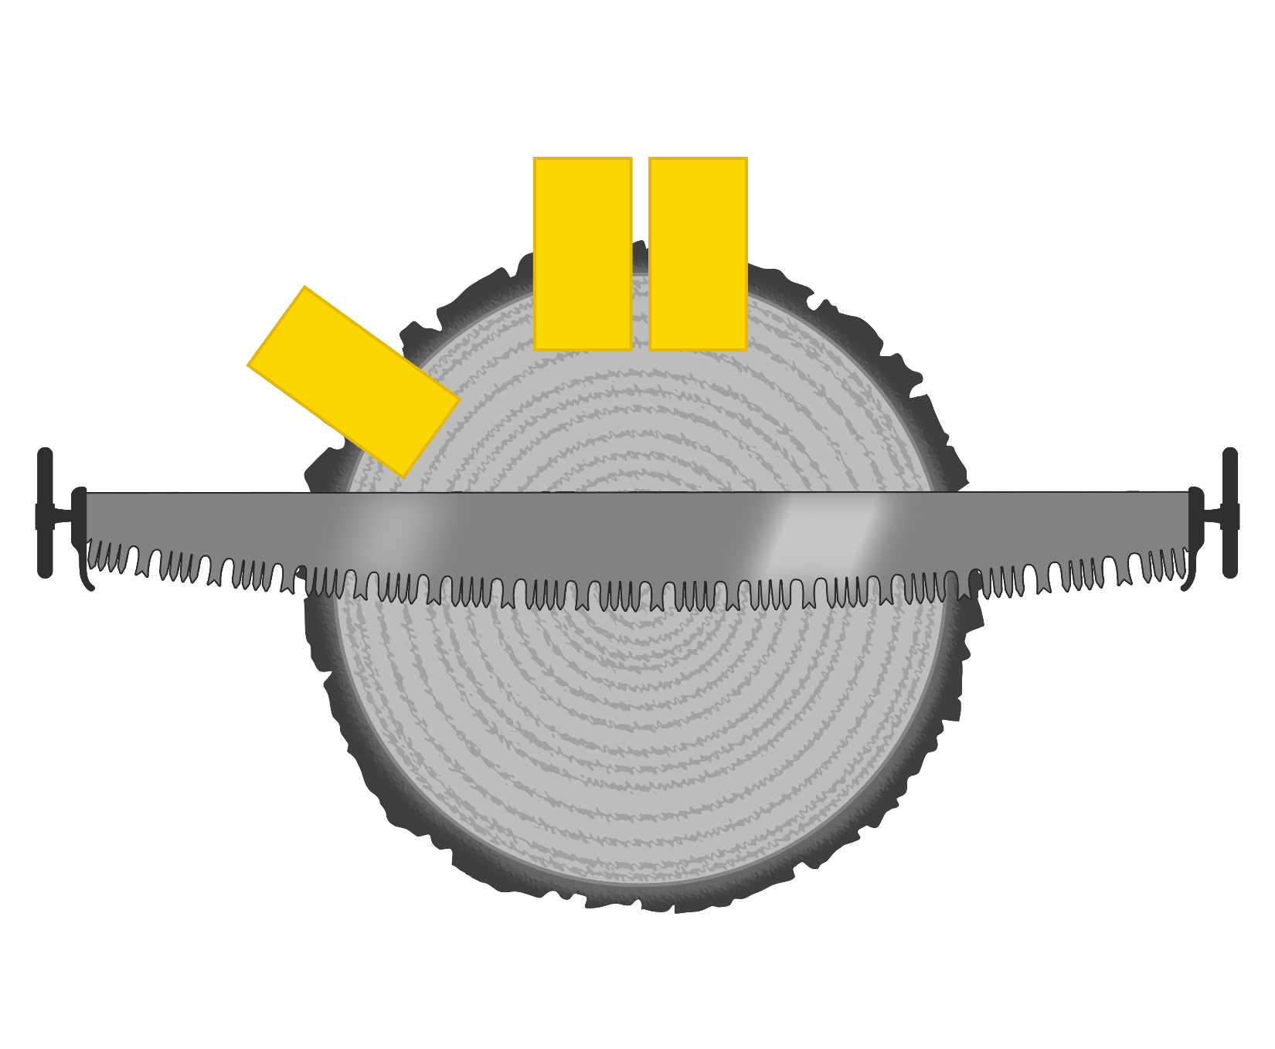
Bucking: Top and Side Bind
Wedging technique for top bind and side bind
Notes:
Say:
If a log has a top and side bind, place wedges at both compression points to prevent the kerf from closing at either bind. Place multiple wedges in this compression area to provide the best mechanical advantage. Multiple wedges help spread the forces required to open the kerf instead of concentrating all the forces on one wedge.
Display Next Slide

Slide 18
Wedges in Felling Operations
Notes:
Say:
A tree that does not have forward lean will require one or more wedges to move its center of weight past the front of the hinge, allowing the tree to fall into the lay. This is referred to as “overcoming the back lean.”
Display Next Slide

Slide 19
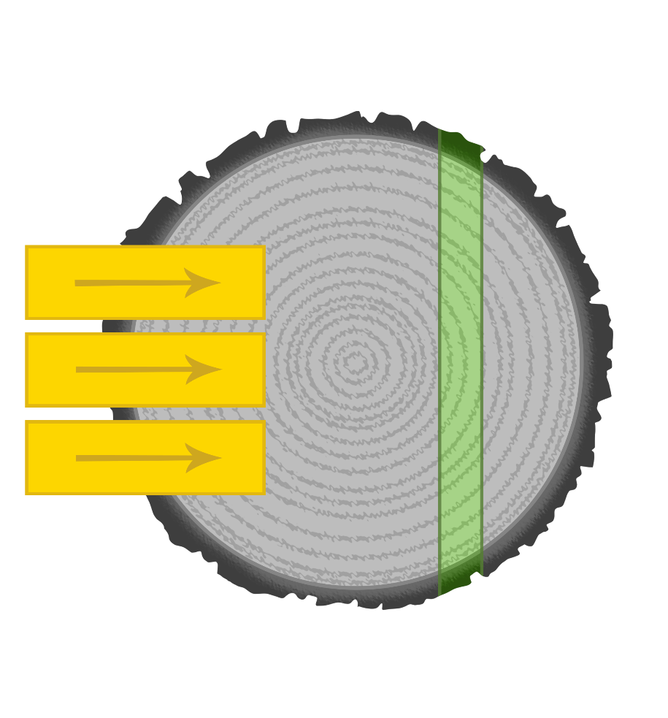
Wedging a Tree
Wedges cooperating
Hinge
Notes:
Say:
As you drive a wedge into the backcut during felling operations, the force developed effectively lifts the back of the tree and moves (rotates on the hinge) the top of the tree forward. This redistributes the center weight of the tree forward into the undercut.
To facilitate this movement, time the cadence of your strike with the forward rocking of the tree. Take special care to watch for limbs, bark, or tops that may be knocked loose. Also, be particularly careful when driving wedges while standing under the bad side of the tree.
Display Next Slide

Slide 20
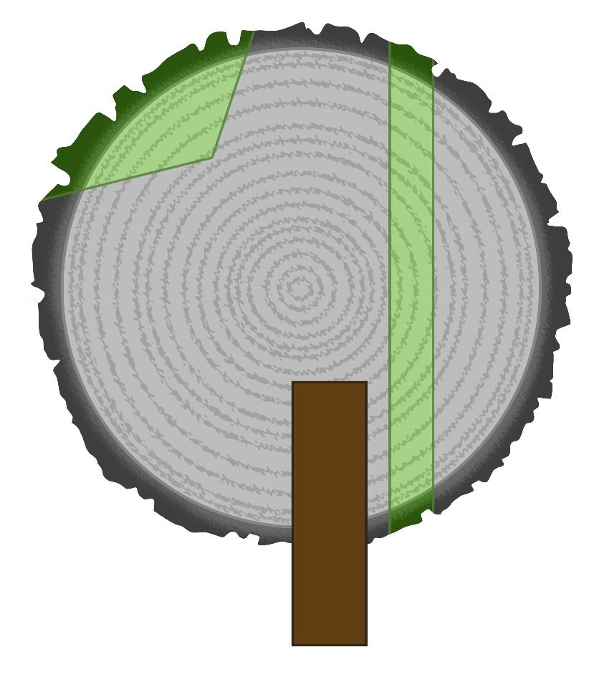
Stabilizing Wedges
Place a stabilizing wedge under the lean, parallel to and behind the hinge.
Trigger
Hinge
Side Lean
Notes:
Say:
For trees with side lean, place a stabilizing wedge under the lean, parallel to and behind the hinge. This can prevent the hinge from failing due to the side weight of the tree. Do not drive this wedge too far in or it may break the hinge. The goal is to support the hinge and not lift the side of the tree. You may have to add more wedges, depending on the amount of side lean and the support needed.
Display Next Slide

Slide 21
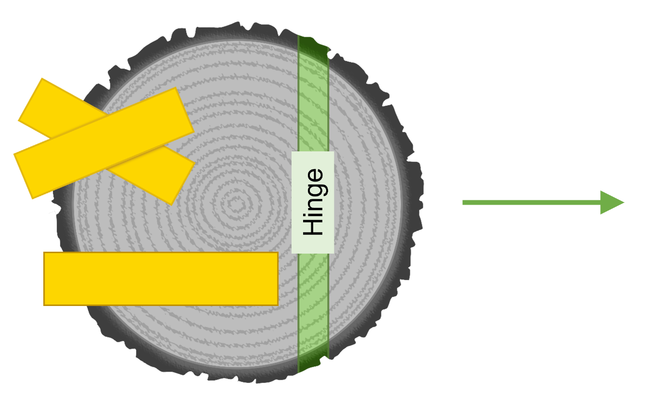
Crossing/Stacking Wedges
Cross wedges to get more lift.
Notes:
Say:
You can stack wedges to increase the amount of lift when you need it. Crossing wedges is a common practice that lessens the likelihood of a wedge popping out of the kerf when struck. Do not stack more than two wedges together. If a wedge pops out of the kerf, the tree may sit back on itself, and you may not be able to reinsert the wedge.
Adding sawdust between stacked wedges adds friction and reduces the likelihood that a wedge will pop out of the kerf.
Display Next Slide

Slide 22
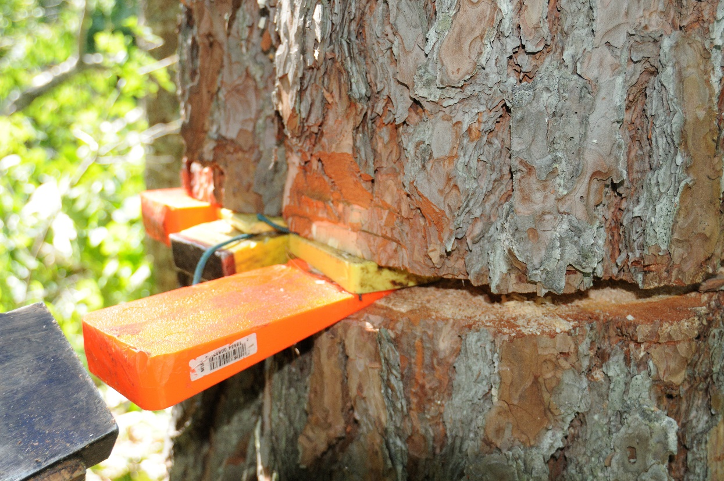
Shims
Notes:
Say:
When choosing to wedge over a back leaning tree, it is important to plan ahead and ensure that you have the right equipment on hand to tackle the job. Combining shims made of short sections of old wedges with a standard wedge can be an effective way to get additional lift.
You can use shims on small-diameter trees when you cannot insert two full-size wedges.
Transition:
With proper use, you can use wedging to overcome back lean if the amount of back lean does not exceed basic limits, there is a solid wedging platform, and the fiber in the hinge is sound and not too thick. Remember, the hinge must be able to bend.
Display Next Slide

Slide 23
Factors Involved in Wedging Back Leans
Tensile strength of the hinge
Elasticity of the hinge
Number and type of wedges needed
Sawyer’s ability to direct power into the wedges
Wedging platform of the tree
Notes:
Say:
Some important factors to consider when wedging a tree with back lean include:
Tensile strength of a hinge
Elasticity of the hinge
Number and type of wedges needed
Your ability to direct power into the wedges
Wedging platform of the tree
Display Next Slide

Slide 24
Tensile Strength
Back leaning tree
Vertical tree
Falling tree
Tension
Compression
Compression
Compression
Compression
Notes:
Say:
Tensile strength is a measurement of the force required to pull something (such as rope, wire, or a structural beam) until it breaks. When driving a wedge into a tree with significant back lean, the extreme tension on the hinge may cause it to fail. If the hinge fails, the tree may not fall in the intended direction and may compromise your escape path.
The tensile strength of fiber contained in the hinge is highly variable, depending on the species of tree, presence of decay, time of year, etc. The tensile strength of the hinge plays an important role in how much lean you can overcome.
Display Next Slide

Slide 25
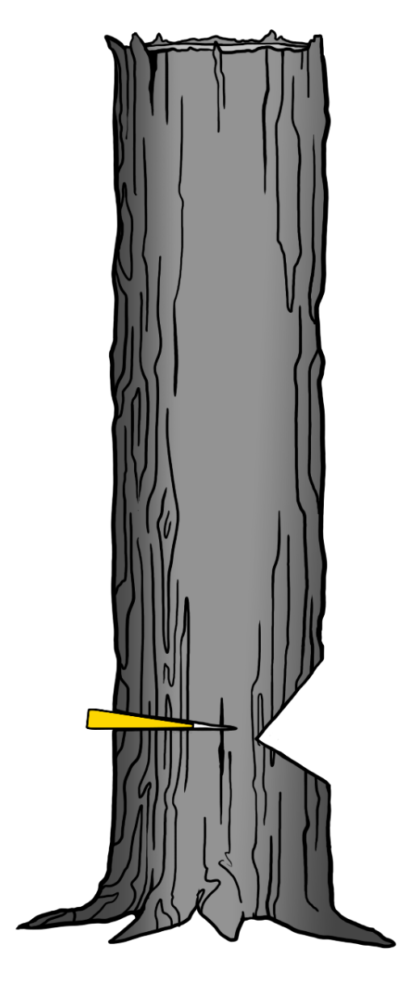
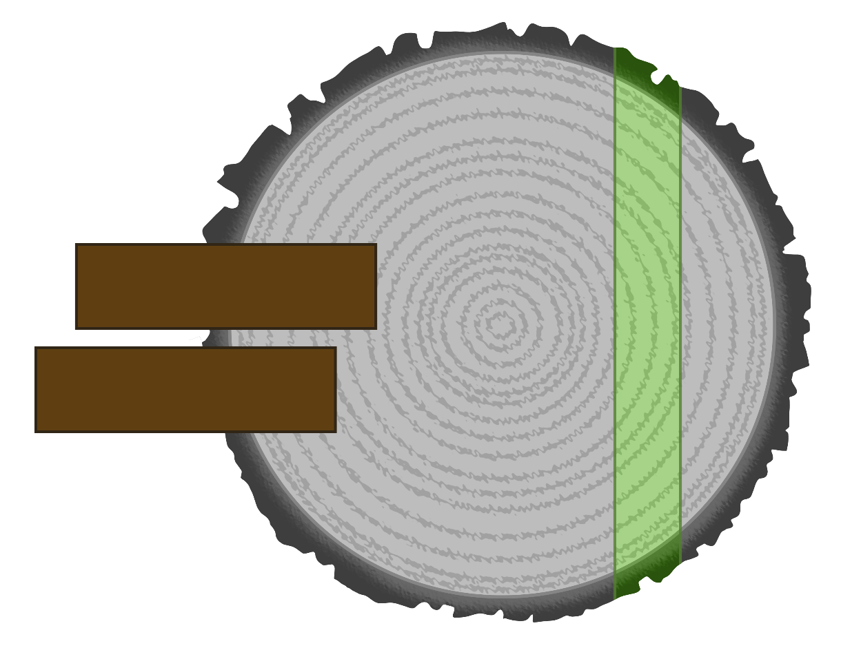
Elasticity of the Hinge
18” Diameter
2x4
2x4
2x4
Hinge
2x4
Notes:
Say:
When we talk about the elasticity of the hinge, we are really saying “will the hinge bend and allow you to guide the tree into the objective?”
Sawyers use the 80+ percent/10- percent guideline to construct hinges. The hinge should be 10 percent (the 10-) or less of the tree’s diameter. You will often find it difficult to bend a hinge if it is thicker than 10 percent. If you constructed the hinge correctly and it is sound, it will bend and allow the tree to fall into the intended lay.
The hinge must bend for the weight in the top of the tree to move. Slide 25 shows that the hinge in an 18-inch diameter tree is about 16 by 1.8 inches and has more wood remaining than four 2-by-4s butted up against each other. As the diameter of the tree increases, the size of the hinge must increase as well. For example, a 40-inch tree would have a 32- by 4-inch hinge, which would be equivalent to bending eight 4-by-4s.
Display Next Slide

Slide 26
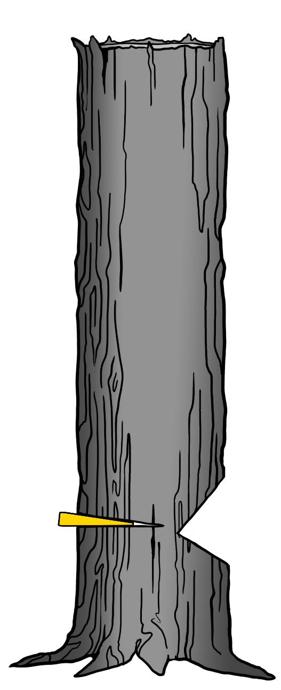
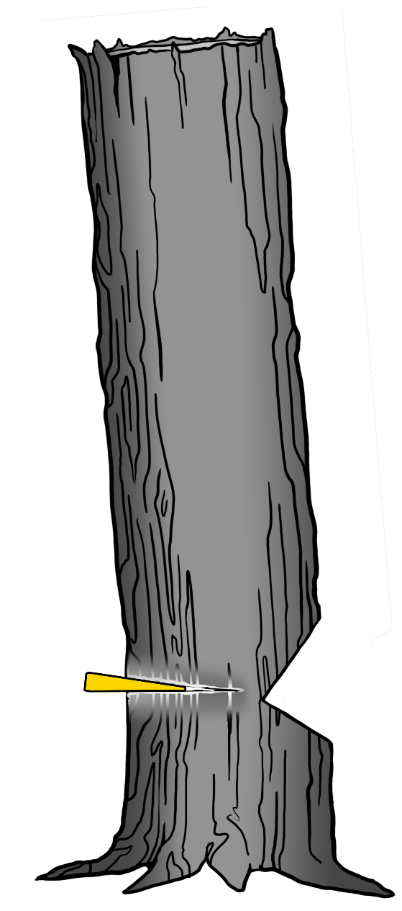
Wedging Platform
Rotten wedge platform, wedge crushes the wood and the tree does not move.
Solid wedge platform, kerf separates and the tree moves into the objective.
Notes:
Say:
The wedging platform must be solid during wedging operations. If rot or thick bark are present where you intend to insert a wedge, the fibers will compress and the wedge will not be able to lift the tree.
Display Next Slide

Slide 27
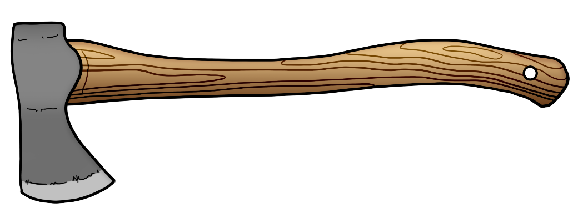
Driving Force
Q: Which ax do you think will drive a wedge with the most force?
A 3-pound single-bit head on a 16-inch handle
or
A 4½-pound single-bit head on a 30-inch handle
Notes:
Ask:
Q: Which ax do you think will drive a wedge with the most force, a 3-pound single-bit head on a 16-inch handle or a 4½-pound single-bit head on a 30-inch handle?
A: A heavier ax with a full-size handle will deliver more power to the wedge and more lifting power into the kerf. The energy transfer from your swing with the ax, to the wedge, and into the kerf, will vary.
Transition:
Next, we will look at back leaning trees and the details of calculating tree segments as well as the corresponding movement at the top of the tree.
Display Next Slide

Slide 28
Tree Segments
Notes:
Say:
Back-leaning trees can present unique challenges. Remember, for a tree to fall in the direction opposite its lean, the weighted center must move past the front of the hinge (i.e., the fulcrum point).
To accomplish this, you drive wedges into the backcut to open the kerf and lift the tree, which results in corresponding forward movement in the top of the tree toward the intended lay.
Calculating the number of segments in a tree is important because it allows you to know how much lift you will need to redistribute the tree’s center weight.
Display Next Slide

Slide 29
What are Tree Segments?
6th segment, 6 inches forward
5th segment, 5 inches forward
4th segment, 4 inches forward
1st segment 1 inch forward
3rd segment, 3 inches forward
1 inch lift
2nd segment, 2 inches forward
Hinge
Notes:
Say:
Think of segments as blocks stacked on top of each other. When you drive a wedge under the bottom corner of the block (segment), as shown in the left image on slide 29, the segment lifts and the opposite corner of the first segment moves forward an equal distance. The more segments in a tree, the more movement you can achieve at the top of the tree.
Click to show inches of movement
The right image on slide 29 shows us that using a wedge to lift a stack of blocks (segments) 1 inch moves the bottom segment 1 inch forward, the second segment 2 inches forward, the third segment 3 inches forward, and so on.
Transition:
Next, you will learn to calculate tree segments and how much lift you will need to move a back-leaning tree into its objective.
Display Next Slide

Slide 30
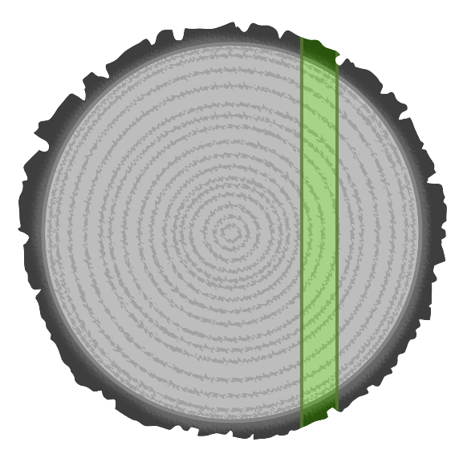
Calculating Segments
Tree measurements
Backcut and hinge: 12 inches
Tree height: 60 feet
Back of tree
Front of hinge
Inches
Calculate
12 inches 12 = 1 (segment size in feet)
60 feet 1= 60 (number of segments)
1 inch wedge x 60 = (amount of movement in inches)
Converted to feet = 5 feet of forward movement
Notes:
Say:
When felling a tree against its lean, you must develop a wedging plan that includes some key pieces of information, including:
Tree height in feet
Amount of back lean in feet
Distance from the back of the tree to the front of the hinge in feet (converted from inches)
Amount of lift needed to redistribute the tree’s center weight
Condition of the hinge fiber
You will use this information to answer the question, “Will I be able to overcome the lean with wedges alone?”
Calculations
When calculating segments, dimensions are based on the distance from the lifting point, or back of the tree, to the front of the hinge.
You can change the number of segments by cutting either a deeper or shallower undercut, thus changing the distance from the back of the tree to the front of the hinge. However, as you shorten the length of the wedging platform, you will require more force to drive the wedge.
You need two factors to calculate how much movement you can achieve:
Height of the tree in feet
Distance from the lifting point to the front of hinge in inches
Convert inches to feet
Instructor Note:
Direct students to the example in the student guide. Walk through the example together and answer any questions they may have.
1. Convert inches to feet
A tree with a segment length of 12 inches converts to how many feet? Divide the distance (in inches) by 12 to get feet.
12 inches ÷ 12 = 1 foot
2. Calculate the number of segments
Determine the number of segments by dividing the height of the tree (in feet) by the segment length (in feet).
Tree height: 60 feet
60 feet (height) divided by 1 foot (segment length) = 60 segments
3. Determine the forward movement of the tree
Calculate forward movement by multiplying the amount of lift (normally 1 inch per wedge) by the number of segments and dividing by 12.
1 inch x 60 segments = 60 inches
60 inches ÷ 12 = 5 feet of movement
Transition:
Using this formula, work through the calculations for exercise 1 in your student guide.
Display Next Slide

Slide 31
Calculation Exercises₁
Example 1
A tree that is 125 feet tall and has a segment length of 36 inches contains how many segments?
Back of tree
Front of hinge
Inches
Backcut and hinge: 36 inches
Tree height: 125 feet
Calculate
Segment size in inches 12 = (segment size in feet)
Tree height segment size in feet = number of segments
Notes:
Instructor Note:
Allow students time to work through exercise 1 in the student guide, then briefly discuss the answers. Answer student questions or address any concerns.
Say:
Example 1: A tree that is 125 feet tall and has a segment length of 36 inches contains how many segments?
Step 1: Convert inches to feet.
36 inches ÷ 12 = 3 feet
Step 2: Calculate the number of segments.
125 feet (height) ÷ 3 feet (segment length) = 42 segments
Transition:
Please work through the calculations in exercise 2 in your student guide. Again, we will compare answers and discuss when everyone finishes.
Display Next Slide

Slide 32
Calculation Exercises₂
Example 2
How much forward movement will happen with 1 inch of lift on a tree with 50 segments?
Back of tree
Front of hinge
Inches
Calculate
Inches of lift x number of segments =
inches of forward movement
Inches of forward movement 12 inches =
feet of forward movement
Notes:
Instructor Note:
Allow students time to work through exercise 2 in the student guide, then briefly discuss the answers. Answer student questions or address any concerns.
Say:
Example 2: How much forward movement will result with 1 inch of lift in a tree with 50 segments?
1 inch x 50 segments = 50 inches
Convert inches to feet: 50 inches ÷ 12 = 4.2 feet of movement
Transition:
Please complete the calculations in exercise 3 in your student guide.
Display Next Slide

Slide 33
Calculation Exercises₃
Example 3
How much forward movement will result from 1.5 inches of lift in a tree with 42 segments?
Back of tree
Front of hinge
Inches
Calculate
Inches of lift x number of segments =
inches of forward motion
Inches of forward motion 12 inches =
feet of forward motion
Notes:
Instructor Note:
Allow students time to work through exercise 3 in the student guide, then briefly discuss the answers. Answer student questions or address any concerns.
Say:
Example 3: How much forward movement will result with 1.5 inches of lift in a tree with 42 segments?
1.5 inches x 42 segments = 63 inches
Convert inches to feet: 63 ÷ 12 = 5.25 feet of movement
Transition:
Next, let’s look at some charts to simplify the math needed when using segments.
Display Next Slide

Slide 34
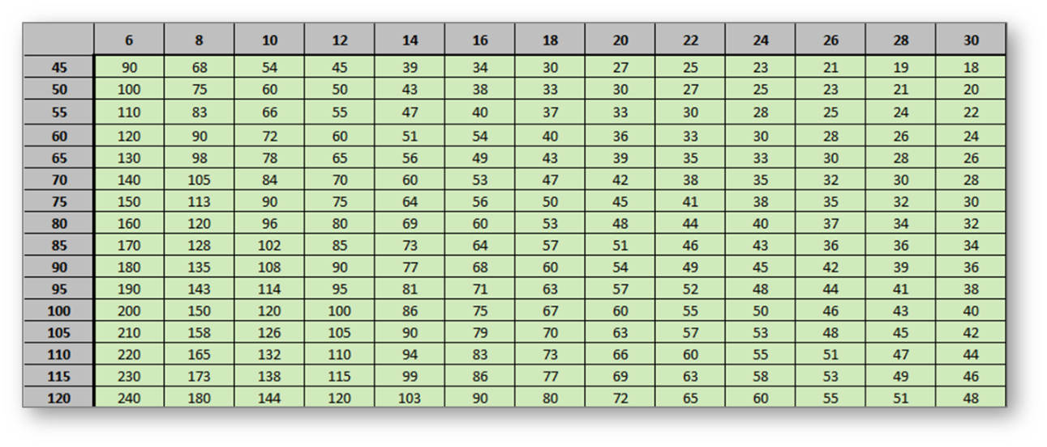
Using Charts₁
Number of Segments Chart
Segment length in inches
Height in feet
Notes:
Say:
Charts have been developed to simplify this process. Remember, the number of segments in a tree tells you how much forward movement you can expect to get with one fully inserted wedge. The charts assume a 3/8 inch kerf and a 1-inch-tall wedge.
In appendix C of your student guide, you have two charts: “Number of Segments” and “Expected Movement”. Turn to the charts as we work through the examples below.
Once you know the height of the tree in feet and segment length in inches, you can use this chart to determine how many segments a specific tree has.
Instructor Note:
Show students how to use the charts to find the answers. After asking each question and giving students a moment to work out the problem on their own, click to reveal the answer on the screen. Click again to clear the answer before moving on to the next question.
Question 1: A tree with a segment length of 16 inches that is 65 feet tall has how many segments?
The student will find the column with 16 inches for segment length, and match that up with 65 feet in the height column. They will see that this tree has 49 segments.
Question 2: A tree with a segment length of 20 inches that is 80 feet tall has how many segments?
The student will follow the column with 20 inches for segment length, match that up with 80 feet in the height column, and see that this tree has 48 segments.
Question 3: A tree with a segment length of 26 inches that is 110 feet tall has how many segments?
The student will follow the column with 26 inches for segment length, match that up with 110 feet in the height column and see that this tree has 51 segments.
Ask:
Do you have any questions on how to calculate segments? Answer any questions appropriately.
Display Next Slide

Slide 35
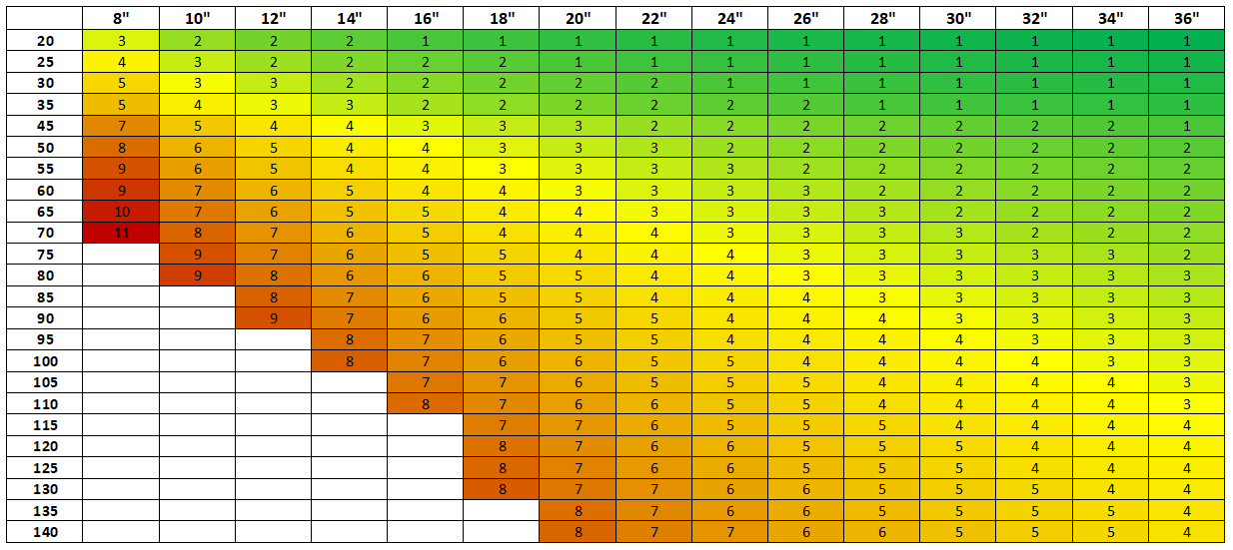
Using Charts₂
Expected Movement Chart
Tree diameter in inches
Tree height in feet
Feet of expected movement toward objective using one fully inserted wedge.
Notes:
Say:
Segment size can vary depending on the depth of the undercut you use. Slide 35 shows a simplified chart that uses an average segment length based on tree diameter compared to tree height, resulting in expected feet of motion toward the objective when using one wedge. This is the simplest chart created, as it uses average segment length per diameter. If you are unsure if you will need to stack wedges, this is a good reference.
If the amount of back lean falls in the green color range on the chart, it is much easier for you to use wedges alone to overcome the lean than if it falls in the yellow or red range. The colors on the chart are not a “go” or “no-go" situation, but they work as a sawyer reference. There is always more to consider when felling trees than just the amount of back lean.
Instructor Note:
Show students how to use the charts to find the answers. After asking each question and giving students a moment to work out the problem on their own, click to reveal the answer on the screen. Click again to clear the answer before moving on to the next question.
Example 1: How far toward the objective will one wedge move a 26-inch diameter tree that is 80 feet tall?
3 feet
Example 2: Will one wedge be enough to fell a 32-inch diameter, 100-foot tall tree with 5 feet of back lean?
No, one wedge will move that tree about 4 feet toward the objective.
Example 3: If a tree has 4 feet of back lean, is 16-inches in diameter, and is 55 feet tall, will one wedge be enough to fell the tree?
Probably not. One wedge would move the tree 4 feet toward the objective. This would make the tree vertical, but this might not be enough motion for the tree to fall into the objective.
Example 4: Will one wedge be enough to fell a tree that is 8 inches in diameter, 55 feet tall, and has 5 feet of back lean?
From the chart, we see that one fully inserted wedge will result in 9 feet of forward motion, enough to result in the tree falling into the objective. Note that 9 feet is in the red section of the chart.
This is a complex operation for many reasons:
It is probably not possible to fully insert a wedge into a tree that is only 8 inches in diameter. That said, you cannot get 9 feet of forward motion with one wedge.
Five feet of back lean puts a lot of stress on the hinge and the wedge platform.
You must drive the wedge while working under the lean of the tree.
Transition:
Now that you have seen the charts, let’s review the calculations again.
Display Next Slide

Slide 36
Segments Summary
Calculate tree height in feet.
Calculate back lean in feet.
Measure length of the backcut plus the hinge in inches.
Convert inches to feet.
Calculate number of segments.
Calculate the forward movement expected with one wedge.
Will you be able to overcome the lean with wedges alone?
Yes: Develop a wedging plan.
No: Use the OHLEC size-up process to reassess.
Notes:
Say:
Summarizing the steps involved in calculating segments:
Calculate the tree height in feet.
Calculate the back lean of the tree in feet.
Measure the length of the backcut plus the hinge in inches.
Convert the backcut measurement from inches to feet.
Calculate the number of segments.
Calculate the forward movement expected with one wedge.
Will you be able to overcome the lean using wedges alone?
Yes: Develop a wedging plan.
No: Use the OHLEC size-up process to reassess.
When it comes to wedging back-leaning trees, there are many more considerations than simply knowing how much motion will result from using one fully inserted wedge.
Transition:
Next, we will look at some limiting factors.
Display Next Slide

Slide 37
Limiting Factors
A correctly constructed undercut and hinge
An accurate measurement of tree height in feet
An accurate measurement of the amount of back lean in feet
The fiber characteristics in the hinge and the wedging platform
The number and size of wedges available.
The size of the ax used to drive wedges.
Elasticity of the hinge
Tensile strength of the hinge
Sawyer’s physical ability to drive a wedge
Notes:
Say:
There are limits to how much you can move a tree. Successfully felling a back-leaning tree depends on several factors:
A correctly constructed undercut and hinge
An accurate measurement of tree height in feet
An accurate measurement of the amount of back lean in feet
The fiber characteristics in the hinge and the wedging platform
The number and size of wedges available
The size of the ax you use to drive wedges
Elasticity of the hinge
Tensile strength of the hinge
Sawyers physical ability to drive a wedge
Display Next Slide

Slide 38
Knowledge Check
When felling, how do wedges work?
During felling, should you place wedges parallel or perpendicular to the hinge?
Which one has a greater mechanical advantage:
A 1- by 12-inch wedge or a 1- by 6-inch wedge?
What can you use when hanging wedges are not available?
Why are segments important?
Can you overcome the lean of this tree?
Segment length: 18 inches | Tree height: 120 feet | Back lean: 4 feet
Notes:
Instructor Note:
Allow students a few moments to answer the questions in the student guide. Discuss the answers and correct any misconceptions.
Q: When felling, how do wedges work?
A: As you strike a wedge, energy transfers into the tree as movement. This movement will lift the back of the tree, causing the top of the bole to move forward into the undercut as weight begins to transfer and rotate forward at the hinge.
Q: During felling, should you place wedges parallel or perpendicular to the hinge?
A: You should place wedges perpendicular to the hinge when driving them. This will lift the tree and transfer weight forward into the undercut. You only seat wedges parallel to the hinge when using them to support the weight of a side-leaning tree.
Q: Which one has a greater mechanical advantage, a 1- by 12-inch wedge or a 1-by 6-inch wedge?
A: A 1- by 12-inch wedge
Q: What can you use when hanging wedges are not available? A: An ax or a Pulaski
Q: Why are segments important?
A: They provide the sawyer with a useful tool to balance mechanical possibility and the sawyer’s physical capacity.
Q: Can you overcome the lean of this tree? Why or why not?
Segment length: 18 inches
Tree height: 120 feet
Back lean: 4 feet
A: Yes.
Number of Segments: 80
Lift needed: one wedge will overcome the lean
Display Next Slide

Slide 39
Summary
In this module, you learned to:
Describe and discuss how wedges work.
Describe the different types of wedges.
Explain the different uses of wedges.
Explain how to use wedges in felling operations.
Calculate the number of segments in a tree.
Notes:
Review
Review the summary objectives listed on the slide.
Display Next Slide

Slide 40
QUESTIONS?
Notes:
Ask:
Are there any additional questions you have about wedges?

